Slide 1
Stormwater Advisory Committee
August 20, 2020

Slide 2

2020 Q2 Financial Overview

Slide 3
2020 Q2 Financial Overview

Slide 4
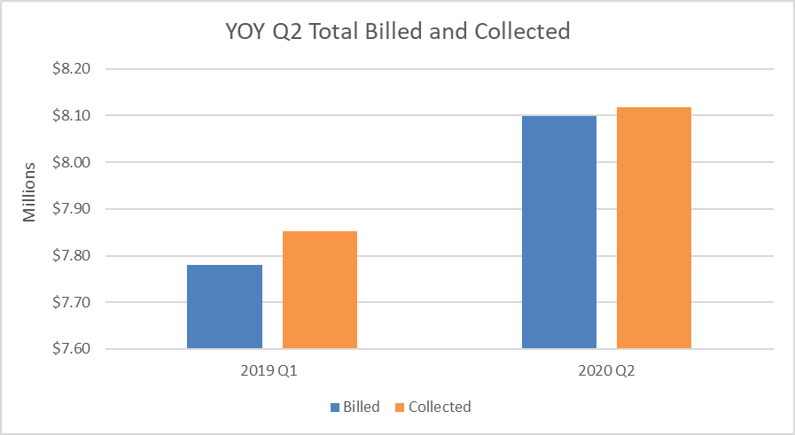
Billing and Revenue Update
All Residential and Non-Residential Accounts

Slide 5
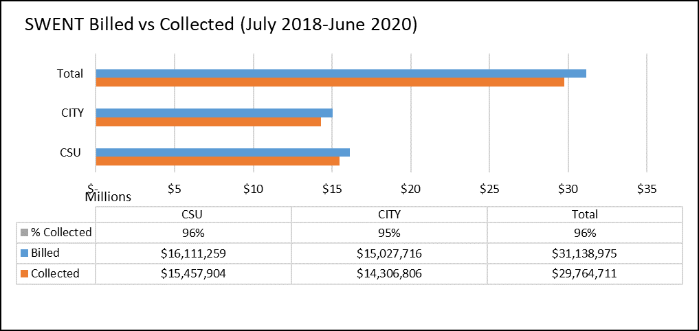
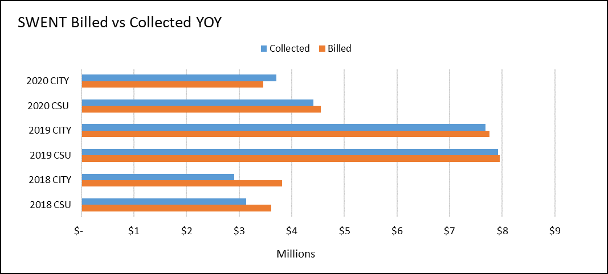
Billing and Revenue Update

Slide 6
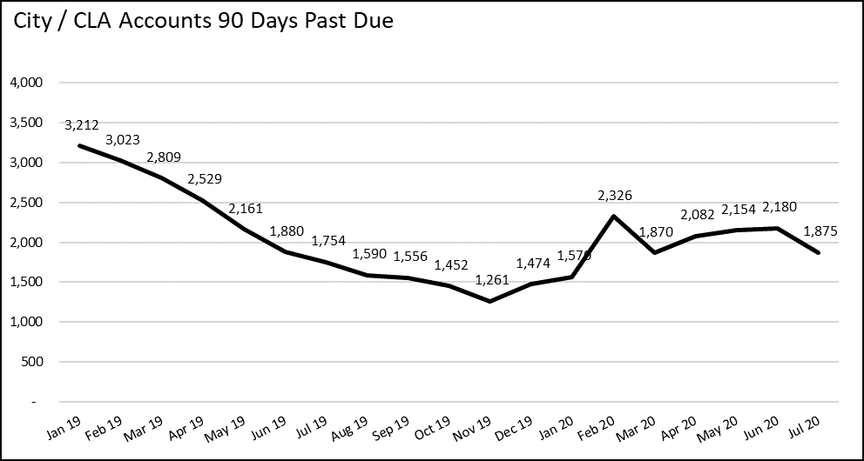
Billing and Revenue Update

