Slide 1
Printers Parkway and
Parkside Drive Roundabout
PUBLIC OPEN HOUSE
CONSTRUCTION: SUMMER 2019
KEVIN DIEKELMAN,
CITY ENGINEERING

Slide 2




City of Colorado Springs,
Public Works Department
  JACOBS Engineering Group
  Hayward, LLC

Slide 3
Property Owner
Resident
Work
Commute

Slide 4
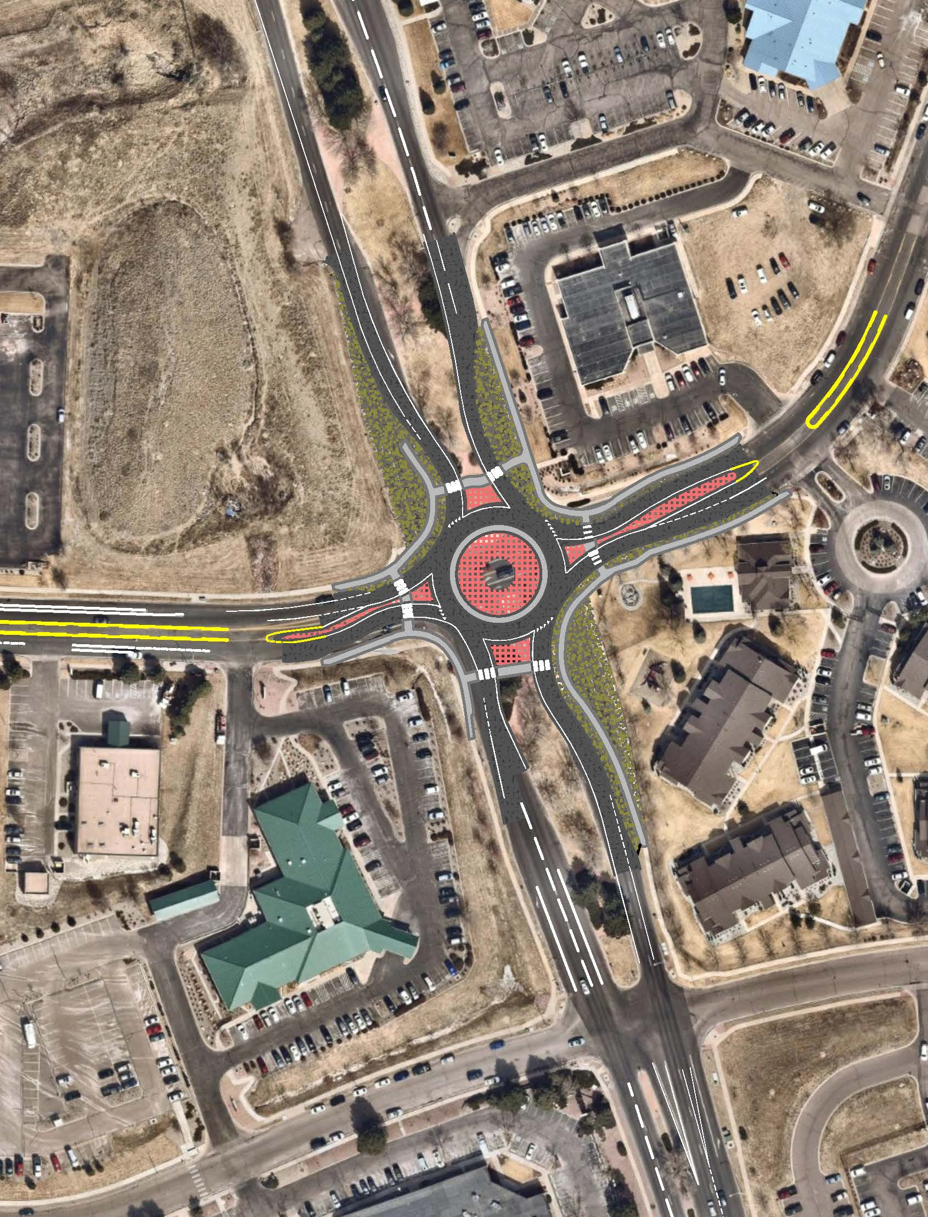
Project Overview
Reconfigure intersection
with a Roundabout
  Storm drain network
  Pedestrian Improvements
  Restripe Approaches
Realign & upgrade
water mains

Slide 5
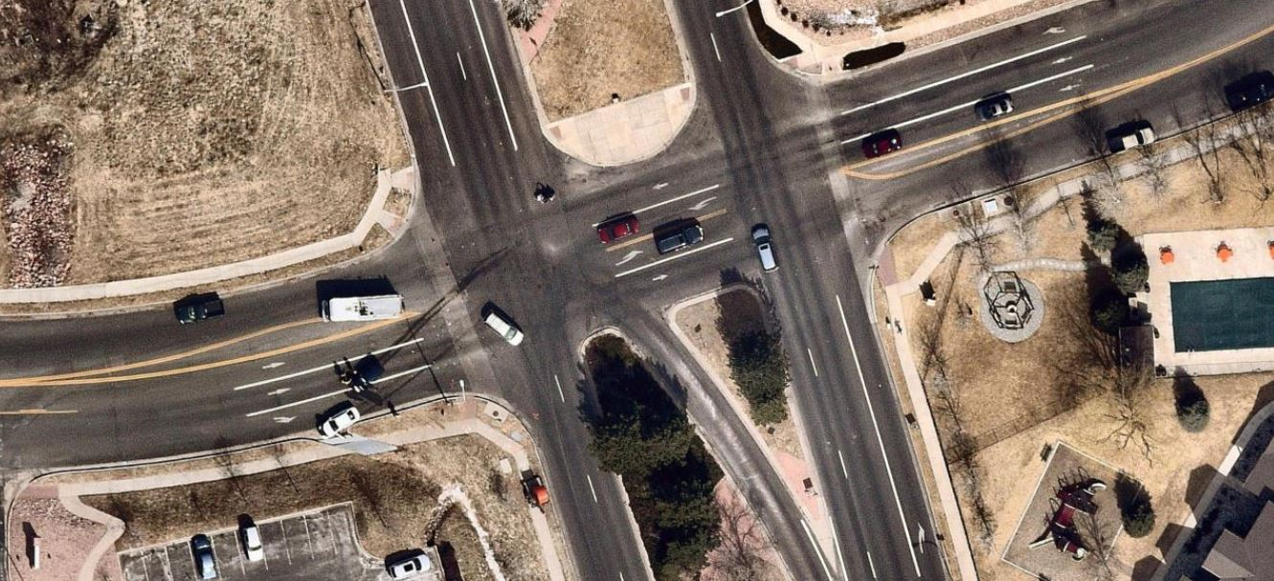
Project Need: Safety!

Slide 6
Project Need: Safety!
High Accident Rating
Federal Safety Grant
Reduce conflict points

Slide 7
Project Need: Safety!
High Accident Rating

Slide 8
Project Need: Safety!
Federal Safety Grant
  Using the 2010 data point, the City applied for and was awarded federal dollars from the Hazard Elimination Safety Program (HES).
  $624,000
  Additional dollars from the City, Springs Utilities, and RTA will complete the Project.

Slide 9
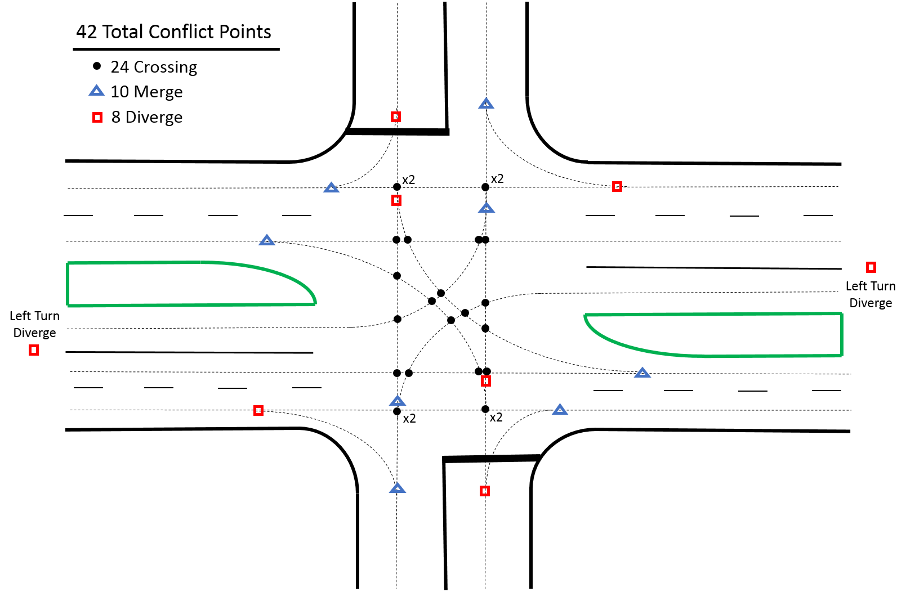
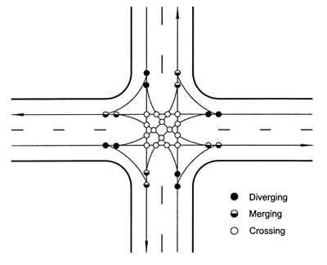
Project Need: Safety!
Reduce conflict points
32 Total Conflict Points
42 Total Conflict Points

Slide 10
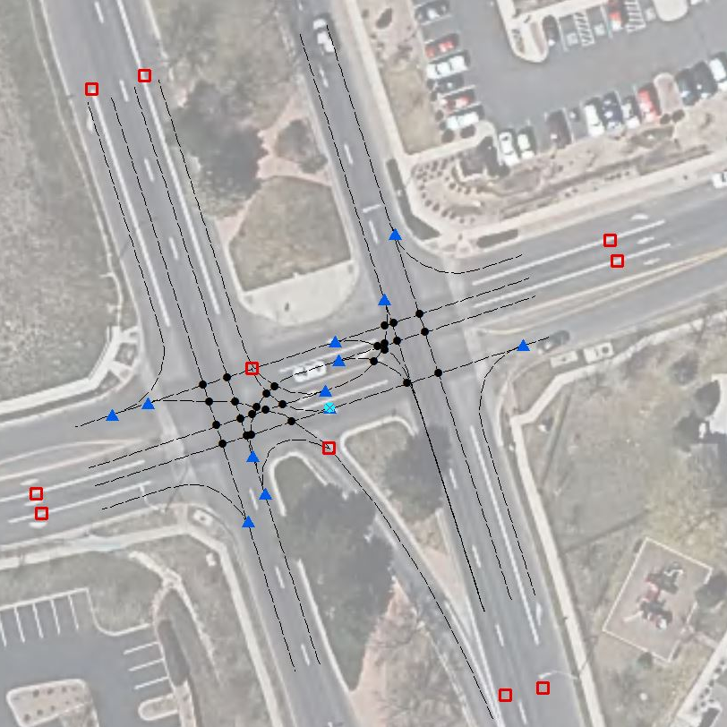
42 Total Conflict Points
52 Total Conflict Points

Slide 11
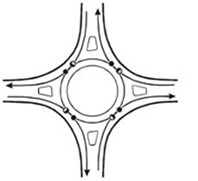
Project Need: Safety!
Reduce conflict points
8 Total Conflict Points

Slide 12
Schedule
Public Outreach
Bid/select construction contractor Summer 2019
6-month schedule anticipated

Slide 13
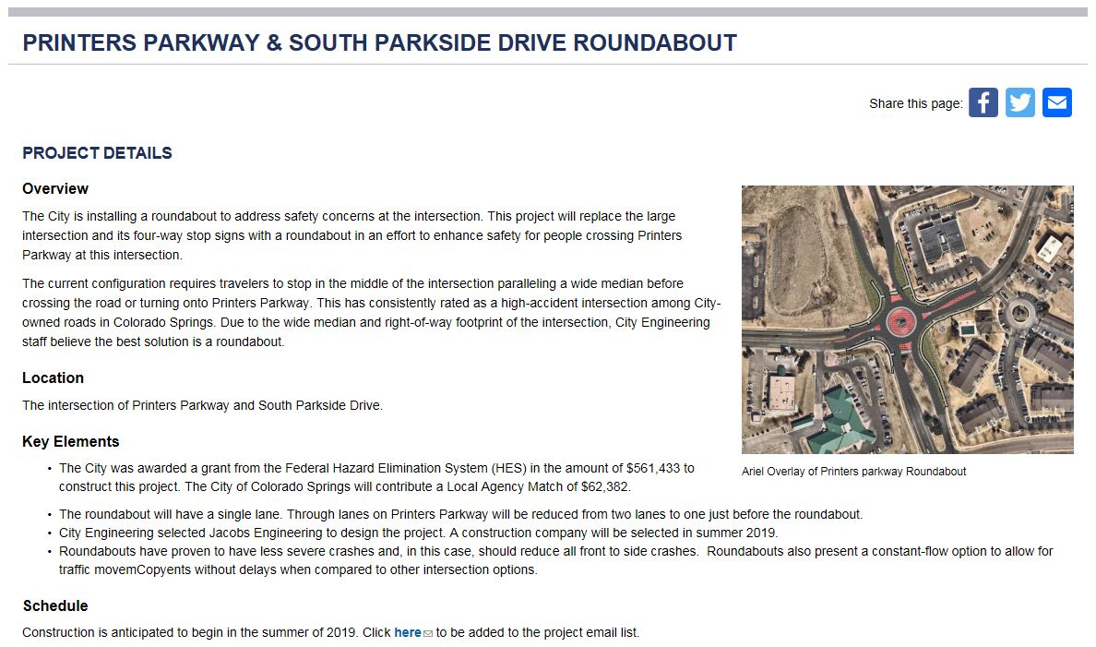
Project Information
https://coloradosprings.gov/printerspkwyimprovements

