Slide 1

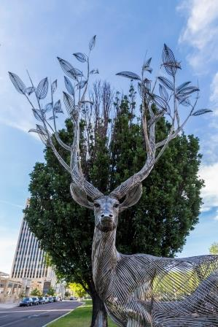

Public Art
Master Plan
City Council Work Session
PRESENTATION DATE:
November 9, 2020
“I’ve Been Dreaming to Be a Tree” by Byeong Doo Moon
Donated by Community Ventures, 2018

Slide 2

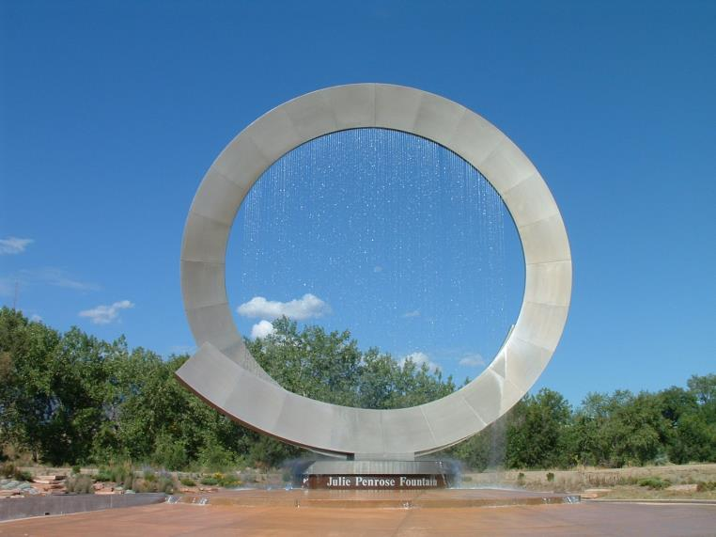
Plan Links
The draft plan, appendix, toolkit, and presentation is available here:
https://coloradosprings.gov/publicartcos
“Julie Penrose Fountain”” by Bill Burgess and David Barber
Donated by the El Pomar Foundation, 2007

Slide 3
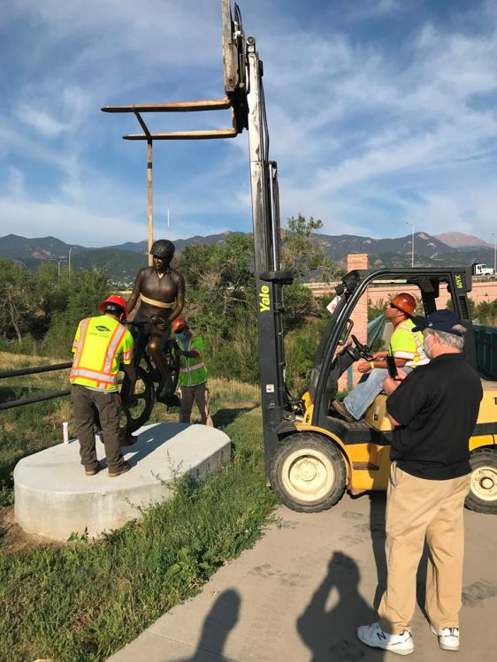
Public Engagement
Steering Committee leadership
Focus group meetings with over 30 Stakeholders
PAC review and input
929 survey responses
Multiple community engagement events
Textizen surveys
“Trailblazer” by Fred Darpino
Donated by Community Ventures, 2009
Repaired and relocated to ATB Park, 2020

Slide 4
Summary of Key Findings
A sustained, permanent public art program is desired by the community. This can only happen with the city’s participation.
Public art is unequally distributed around the city.
The Colorado Springs community would benefit from having a “public art expert” on city staff.
PlanCOS and other guiding documents recommend that we “integrate arts, culture and education as part of the planning process.”

Slide 5
Summary of Key Findings
Developers have a positive view of public art and want a smooth, enticing process to include more of it in their projects.
Public art needs stronger support at a policy level. This will require more education, political support and advocacy. The Colorado Springs community would benefit from having a “public art expert” on city staff.
The time is right to jump-start a public art program.
Public art commission has a passive role that doesn’t allow for effectiveness.
A regional cultural plan is on the horizon.

Slide 6

Recommended Goals
GOAL 1: Begin boldly and sustain momentum
Strategy 1: Commission a special
sesquicentennial project

Slide 7
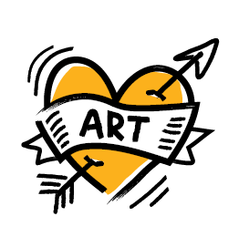
Recommended Goals
  GOAL 2: Demonstrate dedication to public art
Strategy 1: Designate a public art expert
Strategy 2: Evaluate and redefine the role
of the public art commission
Strategy 3: Structure the public art program
Strategy 4: Lead and collaborate with organizations creating public art
Strategy 5: Collaborate with city departments
Strategy 6: Advocate for sustainable funding for public art

Slide 8

Recommended Goals
GOAL 3: Encourage and incentivize placemaking
  Strategy 1: Provide incentives
  Strategy 2: Create incentives for public art in
  established and developing arts districts
  Strategy 3: Make it easier to include art in new developments
  Strategy 4: Advocate for a public art in the URA process

Slide 9
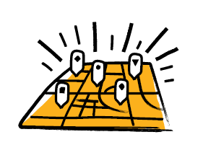
Recommended Goals
GOAL 4: Place art throughout the city
Strategy 1: Focus on opportunity areas
Strategy 2: Develop a neighborhood grant program

Slide 10

Recommended Goals
GOAL 5: Promote and foster the creative economy
Strategy 1: Making it easy to hire local artists
Strategy 2: Market and promote artists
and the art collection

Slide 11

Recommended Goals
GOAL 6: Create an Olympic-level public art collection
Strategy 1: Develop a gold medal public art collection
Strategy 2: Emphasize process over product

Slide 12
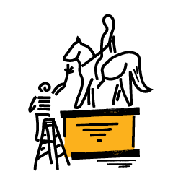
Recommended Goals
Maintain public art collection
Strategy 1: Conduct regular public art collection assessments
Strategy 2: Maintain existing assets
Strategy 3: Evaluate the funding for maintenance
and adjust accordingly

Slide 13
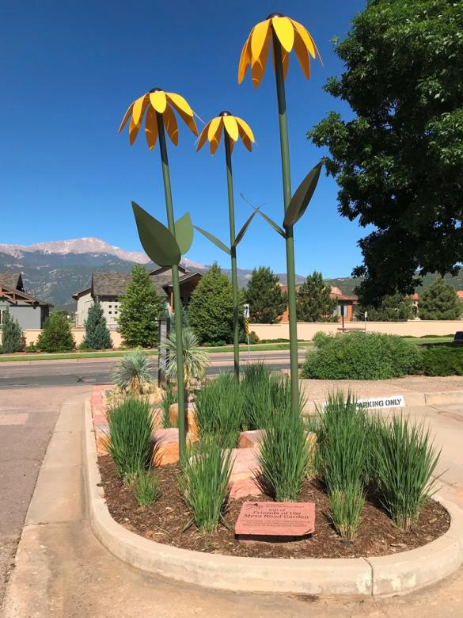
Public Art Commission Representatives
Bernard Byers
Chair
Sandy Friedman
Vice Chair
“Volunteers” by Christopher Weed
Donated by the Friends of Mesa Road Garden, 2017

Slide 14
QUESTIONS / DISCUSSION

