Slide 1



2020 ESG-CV Applicant Presentation
Naomi Clark
naomi.clark@coloradosprings.gov
Community Development Division
719-385-6609
June 5th 2020
Notes:
Good Afternoon,
My name is Naomi Clark and I am a team member with the Community Development Division for the City of Colorado Springs. This presentation is for the 2020 Emergency Solutions Grant funding specifically earmarked by the Department of Housing and Urban Development to help combat the coronavirus outbreak.
Today’s presentation will focus on all the information and details organizations will need to successfully determine their eligibility to apply for these funds.

Slide 2

Agenda
Introduction
ESG Overview
Coordinated Entry, written standards, and administrative requirements
ESG waiver information
Coronavirus grant information
Funding priorities
Recordkeeping and Reporting
Submitting your application and review
General Information
Notes:
For today’s presentation we will start out with a brief introduction of the funding available and some information on what organizations are eligible to apply.
We then take some time to go over the ESG program elements to include coordinated entry, the written standards and administrative requirements.
Next, we will talk about the specific waiver implemented by HUD for the ESG-CV program, along with some specific information about the grant funding in light of the coronavirus.
We will them move into the priorities for funding as outlined by the city of Colorado Springs, record keeping and reporting for grants, and submitting an application information.
Lastly, we will end with some general information for all applicants. So let’s get started!

Slide 3
Introduction
CARES Act: $2.2 trillion
HUD: $12 billion
Community Development Block Grant (CDBG-CV): $5 billion → City of Colorado Springs: $1.8 million
Emergency Solutions Grant (ESG-CV): $4 billion → City of Colorado Springs: $887k
Who is eligible?
Funding Information
Community Development Block Grant (CDBG-CV)
$ 1 million
Emergency Solutions Grant (ESG-CV)
$400,000
Minimum request amount
$50,000 (both programs)
The Community Development Division has opened applications for the CDBG-CV and ESG-CV funding to help organizations prevent, prepare for, and respond to the coronavirus.
Non-profit organizations, faith based organizations, and public agencies are invited to apply.
Notes:
In response to the coronavirus outbreak, the CARES Act made $12 billion available to the U.S. Department of Housing and Urban Development. This first phase of CARES Act funding made $5 billion available in additional Community Development Block Grant (CDBG-CV) funds and $4 billion available in Emergency Solutions grant (ESG-CV) funding to all formula grantees in the country. As a grantee jurisdiction, the City of Colorado Springs Community Development Division received a special allocation of CDBG-CV and ESG-CV funds to prevent, prepare for, and respond to the coronavirus and meet our community’s immediate needs.
So who is eligible?
The ESG-CV application is eligible to all homeless service providers who fall the following statuses: non-profit organization , a faith based organization or agency, and/or any other public agency; all ESG-CV applicants must collaborate with the Pikes Peak Continuum of Care. We would like to stress that unlike the regular Emergency solutions grant funds made available every year, this awarding period is specifically to assist organization in preventing, preparing for, and responding to the coronavirus.
At this time the City of Colorado springs has approximately $400,000 in Emergency Solutions grant funding available. It is not clear the City will be receiving more funds from HUD, from either the CARES Act funds or any future emergency packages, so the Division is reserving some of those ESG-CV funds for the emergency isolation shelter costs and to address any future outbreaks affecting those experiencing homelessness.
For all applicants the minimum request for application funds is $50,000 for the ESG-CV program.
Now, we additionally have 1 million dollars available in our Community Development Block Grant program. For details about that program please visit our website to view the CDBG-CV presentation and review our grant resource guide for details.

Slide 4

Emergency Solutions Grant (ESG)
About ESG
The Emergency Solutions Grant (ESG) program was a result of a revised program from the Homeless Emergency Assistance and Rapid Transition to Housing Act of 2009. The ESG Interim Rule took effect on January 4th 2012 and reflected the change in the programs focus to assisting people to quickly regain stability in permanent housing after experiencing a housing crisis and/or homelessness.
The Community Development Division manages the City of Colorado Springs entitlement funds from the U.S. Department of housing and Urban Development. Our mission is to create strong, sustainable, inclusive communities and quality affordable homes for all people in Colorado Springs.
Notes:
The Emergency Solutions Grant (ESG) program was a result of a revised program from the Homeless Emergency Assistance and Rapid Transition to Housing Act of 2009. The ESG Interim Rule took effect on January 4th 2012 and reflected the change in the programs focus to assisting people to quickly regain stability in permanent housing after experiencing a housing crisis and/or homelessness.
The Community Development Division manages the City of Colorado Springs entitlement funds from the U.S. Department of housing and Urban Development. Our mission is to create strong, sustainable, inclusive communities and quality affordable homes for all people in Colorado Springs.

Slide 5
Emergency Solutions Grant (ESG)
Program components of the ESG program
Street Outreach
Emergency Shelter
Homelessness Prevention
Rapid Re-housing
Data collection
What types of activities are eligible for ESG program funds?
Under the program components of ESG funds eligible activities can include shelter operations, rental/utility assistance, housing relocation and stabilization services, costs for managing the HMIS database, and more.
**For the 2020 ESG-CV all the above program components will be considered for funding. **
Purpose
The program provides funding to:
Engage homeless individuals and families living on the street;
Improve the number and quality of emergency shelters for homeless individuals and families;
Help operate these shelters;
Provide essential services to shelter residents;
Rapidly re-house homeless individuals and families; and
Prevent families and individuals from becoming homeless.
Notes:
So What is the purpose of the ESG program?
There are 6 major goals that the ESG program aims to accomplish:
Engage homeless individuals and families living on the street;
Improve the number and quality of emergency shelters for homeless individuals and families;
Help operate these shelters;
Provide essential services to shelter residents;
Rapidly re-house homeless individuals and families; and
Prevent families and individuals from becoming homeless.
In light of these goals there are 5 program components of the ESG program.
Street Outreach
Emergency Shelter
Homelessness Prevention
Rapid Re-housing
Data collection
Under the program components of ESG funds, additional eligible activities can include shelter operations, rental/utility assistance, housing relocation and stabilization services, costs for managing the HMIS database, and more.
This funding cycle all 5 program components will be considered for funding.

Slide 6
Coordinated Entry
In compliance with section 576.400(b) of the ESG Interim Rule, all ESG subrecipients within the PPCoC service area must coordinate and integrate, to the maximum extent practicable, ESG-funded activities with other programs targeted to people experiencing homelessness in the PPCoC area to provide a strategic, community-wide system to prevent and end homelessness.
The City Requires that all subrecipient service providers will:
Exceptions to Coordinated Entry requirement:
Participate in the coordinated assessment system
Establish a staff member as a point of contact for other case managers and members of the PPCoC (Pikes Peak Continuum of Care).
Attend all coordinated training for case managers within the homeless provider system.
Domestic violence service providers
Homelessness prevention programs
For questions about PPCoC membership please visit: www.ppchp.org/members/
Notes:
So in compliance with the ESG interim rule all ESG subrecipients within the PPCOC (Pikes peak continuum of care) service area must coordinate and integrate, to the maximum extent practicable, ESG-funded activities targeted to people experiencing homelessness within that area in order to provide a strategic, community-wide system to prevent and end homelessness.
The City requires that all subrecipients service providers will:
Participate in the coordinated assessment system
Establish a staff member as a point of contact for other case managers and members of the PPCoC (Pikes Peak Continuum of Care).
Attend all coordinated training for case managers within the homeless provider system.
Exceptions to Coordinated Entry requirement:
Domestic violence service providers
Homelessness prevention programs
For questions about PPCOC membership please visit www.ppchp.org/members/

Slide 7
Coordinated Entry
Client Eligibility
All applicants must be assessed to determine eligibility for receipt of ESG-funded services. Client assessment and determination of ESG eligibility includes the cost of staff time to complete an intake and/or assessment even if it’s determined from the evaluation the applicant is not eligible for ESG program assistance.
Some important things to note:
Subrecipients are responsible for determining and documenting client eligibility
The City of Colorado Springs will not reimburse an agency for funds expended on clients that are found to be ineligible for ESG
Service providers receiving funds under the ESG Program cannot discriminate against a group of people presenting as a family based on the composition of the family.
Subrecipients will be expected to adhere to the reporting, performance, and outcome evaluations standards as outlined in the City of Colorado Springs written standards.
Notes:
The ESG subrecipient is responsible for determining and documenting client eligibility. It is expected that within two weeks the agency will close out the client file by either serving the client, providing a referral for the client, or notifying the client that the client is not eligible for ESG assistance.
A few important things to note:
Subrecipients are responsible for determining and documenting client eligibility
The City of Colorado Springs will not reimburse an agency for funds expended on clients that are found to be ineligible for ESG
Service providers receiving funds under the ESG Program cannot discriminate against a group of people presenting as a family based on the composition of the family.
Subrecipients will be expected to adhere to the reporting, performance, and outcome evaluations standards as outlined in the City of Colorado Springs written standards.
We are asking organizations to record their outcomes and have benchmarks they are reaching for.

Slide 8
Written Standards
Written Standards
The City of Colorado Springs has developed written standards for the use of ESG funds by service providers. These standards were created in coordination with the Pikes Peak Continuum of Care (PPCoC) and were formulated to:
Establish community wide expectations on the operations of projects within the community
Ensure a system that is transparent to users and operators
Establish a minimum set of standards
Organizations who apply for and are awarded ESG grant funds must certify that they have reviewed these standards, and understand they are expected to meet or exceed these standards upon award. Please visit the ESG information page on the Community Development Division website for more details.
* Updates to the ESG Written Standards are subject to change. If awarded, subrecipients will be expected to adhere to any updated requirements.
Notes:
Written Standards
The City of Colorado Springs has developed written standards for the use of ESG funds by service providers. These standards were created in coordination with the Pikes Peak Continuum of Care (PPCoC) and were formulated to:
Establish community wide expectations on the operations of projects within the community
Ensure a system that is transparent to users and operators
Establish a minimum set of standards
Organizations who apply for and are awarded ESG grant funds must certify that they have reviewed these standards, and understand they are expected to meet or exceed these standards upon award. Please visit the ESG information page on the Community Development Division website for more details.
* Updates to the ESG Written Standards are subject to change. If awarded, subrecipients will be expected to adhere to any updated requirements.

Slide 9
Administrative Requirements
Administrative Requirements
Termination, grievance and conflict of interest policy
Fair housing requirements
Equal access requirements
Habitability standards
Lead based paint requirements
**As advised updates to the ESG Written Standards are subject to change. If awarded, subrecipients will be expected to adhere to any updated requirements.**
In addition to basic eligibility requirements there are administrative requirements outlined in the City’s written standards. These requirements cover the following areas:
Notes:
In addition to basic eligibility requirements there are administrative requirements outlined in the City’s written standards. These requirements cover the following areas:
Termination, grievance and conflict of interest policies, Fair housing requirements, Equal access requirements, Habitability standards and lead based paint requirements .
Subrecipients must establish and maintain sufficient records to enable the city and HUD to determine whether ESG requirements are being met. subrecipients must also keep documentation showing that ESG grant funds were spent on allowable costs in accordance with the requirements for eligible activities and additionally must maintain all the case file records. This does include records for persons seeking assistance determined to be ineligible.
Please be sure you have carefully and fully reviewed the city's written standards for information on each of the listed administrative requirements.

Slide 10
Waiver Information
1. HMIS Lead Activities
2. Re-evaluations for Homelessness prevention assistance
Previous requirement: ESG funds may be used to pay the costs of managing and operating the HMIS, provided that the ESG recipient is the HMIS Lead.
Temporary Waiver: To enable ESG-funded projects to participate in HMIS as required, HUD has authorized the use of ESG funds for managing and operating the HMIS for agencies other than the HMIS Lead.
What does this mean: Organizations/agencies may apply for ESG funds to upgrade and/or enhance their existing HMIS system.
Previous requirement: Homelessness prevention assistance is subject to re-evaluation of each program participant’s eligibility need for assistance not less than once every 3 months.
Temporary Waiver: To alleviate the volume of case management for service providers the required frequency of re-evaluations for homelessness prevention assistance under section is waived for up to 2-years beginning as of March 31st 2020.
What does this mean: Organizations/agencies may provide up to two years of assistance so long as re-evaluations are conducted at least every 6 months.
Notes:
So let’s talk about some of the HUD issued waivers to some of the ESG requirements in light of the impact of the coronavirus. First, be advised all the described waivers are TEMPORARY and only apply for the current award funds under the ESG-CV FUNDS ONLY.
FIRST, hmis lead activities- Previous requirement: ESG funds may be used to pay the costs of managing and operating the HMIS, provided that the ESG recipient is the HMIS Lead.
Waiver: To enable ESG-funded projects to participate in HMIS as required, HUD has authorized the use of ESG funds for managing and operating the HMIS for agencies other than the HMIS Lead.
What does this mean: Organizations/agencies may apply for ESG funds to upgrade and/or enhance their existing HMIS system. It is important to emphasize that you must already have a system in place to apply for funds under this waiver. Implementation of a brand new HMIS that did not previously exist is not permitted.
Next is the re-evaluations for homelessness prevention
The Previous requirement: Homelessness prevention assistance was subject to re-evaluation of each program participant’s eligibility need for assistance not less than once every 3 months.
Waiver: To alleviate the volume of case management for service providers the required frequency of re-evaluations for homelessness prevention assistance under section is waived for up to 2-years beginning as of March 31st 2020.
What does this mean: Organizations/agencies may provide up to two years of assistance so long as re-evaluations are conducted at least every 6 months.

Slide 11
Waiver Information
3. Housing Stability Case Management
4. Match
Previous Requirement: Program participants receiving homelessness prevention or rapid re-housing assistance were required to meet with a case manager not less than once per month, unless certain statutory prohibitions apply.
Temporary Waiver: Due to the impacts of COVID-19 organizations are reporting limited staff capacity as staff members are home for a variety of reasons related to COVID-19. HUD has temporarily suspended the monthly case management requirement.
What does this mean: As of the memorandum date, case managers are not required to meet with clients once per month. This waiver expires August 22nd 2020.
Previous requirement: Program participants were required to make matching contributions in an amount that equals (100%) the amount of ESG funds allocated by the City.
Temporary Waiver: Based on the economic impacts of the coronavirus on financial systems of many organizations/agencies HUD has temporarily suspended this requirement.
What does this mean: This match requirement has been temporarily waived and is specific to the ESG-CV funds addressing impacts of coronavirus only. Any subrecipients currently receiving ESG funding for the regular program year are still required to meet standard ESG requirements.
Notes:
The next waiver we will talk about is the Housing Stability and case management requirement.
Previous Requirement: Program participants receiving homelessness prevention or rapid re-housing assistance were required to meet with a case manager not less than once per month, unless certain statutory prohibitions apply.
Temporary Waiver: Due to the impacts of COVID-19 organizations are reporting limited staff capacity as staff members are home for a variety of reasons related to COVID-19. HUD has temporarily suspended the monthly case management requirement.
What does this mean: As of the memorandum date, case managers are not required to meet with clients once per month. This waiver expires August 22nd 2020.
Moving on the next waiver deals with the financial match requirement of the esg program.
Previous requirement: Program participants were required to make matching contributions in an amount that equals (100%) the amount of ESG funds allocated by the City.
Temporary Waiver: Based on the economic impacts of the coronavirus on financial systems of many organizations/agencies HUD has temporarily suspended this requirement.
What does this mean: This match requirement has been temporarily waived and is specific to the ESG-CV funds addressing impacts of coronavirus only. Any subrecipients currently receiving ESG funding for the regular program year are still required to meet standard ESG requirements.

Slide 12
Waiver Information
Previous requirement: Restriction of rental assistance to units with rent at or below fair market rent levels.
Temporary waiver: To assist organizations and housing providers, HUD is waiving the limit on rental assistance
to rents that are equal to or less than the fair market value, as established by HUD. This will assist recipients and subrecipients in more quickly locating additional units
to house individuals and families experiencing homelessness.
What does this mean: The FMR restriction is waived for any individual or family receiving Rapid Re-housing or Homelessness Prevention assistance who executes a lease for
a unit during the 6-month period beginning on March 31st 2020.
The ESG recipient or subrecipient must still ensure that the units in which ESG assistance is provided to these individuals and families meet the rent reasonableness standard.
5. Restriction of rental assistance to units with rent at or below fair market rent
Notes:
The last waiver concerns the restrictions of rental assistance to units with rent at or below fair market rent.
Previous requirement: Restriction of rental assistance to units with rent at or below fair market rent levels.
Temporary waiver: To assist organizations and housing providers, HUD is waiving the limit on rental assistance
to rents that are equal to or less than the fair market value, as established by HUD. This will assist recipients and subrecipients in more quickly locating additional units
to house individuals and families experiencing homelessness.
What does this mean: The FMR restriction is waived for any individual or family receiving Rapid Re-housing or Homelessness Prevention assistance who executes a lease for
a unit during the 6-month period beginning on March 31st 2020.
The ESG recipient or subrecipient must still ensure that the units in which ESG assistance is provided to these individuals and families meet the rent reasonableness standard.

Slide 13

CARES Act and HUD Information
In addition to meeting the basic eligibility requirements for the CDBG and ESG programs (outlined in this guide), all proposed projects MUST provide the following:
A documentable connection between the coronavirus impact on client needs and the applicant’s service delivery.
Assurance that the applicant is not receiving financial assistance from other sources for the expenses detailed in their application AND the ability to determine that a clients are not being not met from other funding sources.
Notes:
Whether you are applying for ESG or CDBG funding, in addition to meeting the basic eligibility requirements for either program (outlined in this guide), all proposed projects MUST provide the following:
A documentable connection between the coronavirus impact on client needs and the applicant’s service delivery.
Assurance that the applicant is not receiving financial assistance from other sources for the expenses detailed in their application AND the ability to determine that a clients needs not being not met from other funding sources.
As the coronavirus began to impact our communities the Cares Act provided various agencies with funding to help prevent, prepare for, and respond to the crisis.
HUD guidelines are very clear in that this funding most go towards that aim. As such, applicants need to be mindful that in addition to providing a detailed narrative in their applications on how the coronavirus has impacted their clients and programmatic activities, that ultimately if an organization is unable to provide a very detailed documentable connection between their request and the coronavirus impact on their clients, they would be ineligible for reimbursement.

Slide 14
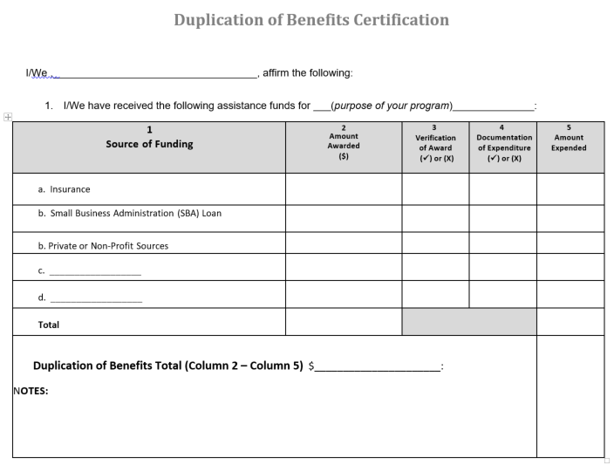
Notes:
HUD has made it clear that ESG and CDBG funds are not meant for activities that other disaster recovery funds are already covering. HUD has advised that if an organization either has the funds needed to address the coronavirus impact on their clients and/or can obtain the funds from another source, whether that be private, public, etc. type funds, that the grant funds under the ESG and/or CDBG program are not to be used.
We highly recommend that organizations and agencies consult with their finance team and board to ensure that they have exhausted all options to address their clients needs. This is a worksheet template that all awardees will need to fill out prior to signing their ESG-CV agreement, so feel free to use this in conducting a pre-application duplication of benefits analysis.

Slide 15

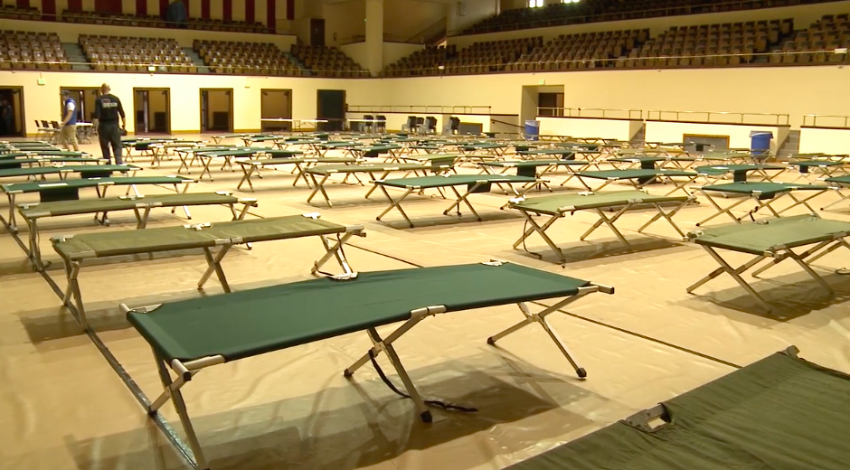
Funding Priorities
1. Emergency Shelter
2. Street Outreach
Funds the operations for low barrier, emergency shelters facing extra operational costs due to the coronavirus outbreak. Eligible activities include: Case management, onsite services (such as patient health services), renovations (rehab and conversion), maintenance, rent & utilities, security, fuel, equipment, insurance, food, furnishings, supplies, and motel vouchers (only when the shelter system cannot safely accommodate families).
These activities are designed to meet the immediate needs of the unsheltered homeless population by connecting them with emergency shelter, housing, and/or critical health services. Eligible activities include: Engagement, case management, emergency health services, transportation, services for special populations.
Notes:
For the current ESG-CV grant funding the city has outlined the following funding priorities for awarding.
First Emergency Shelter
Funds the operations for low barrier, emergency shelters facing extra operational costs due to the coronavirus outbreak. Eligible activities include: Case management, onsite services (such as patient health services), renovations (rehab and conversion), maintenance, rent & utilities, security, fuel, equipment, insurance, food, furnishings, supplies, and motel vouchers (only when the shelter system cannot safely accommodate families).
Next is street outreach. These activities are designed to meet the immediate needs of the unsheltered homeless population by connecting them with emergency shelter, housing, and/or critical health services. Eligible activities include: Engagement, case management, emergency health services, transportation, services for special populations.

Slide 16
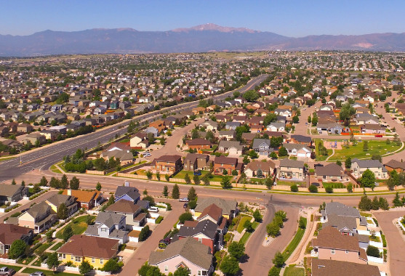

Funding Priorities
3. Homelessness Prevention
4. Rapid Re-housing
These are programs that provide housing relocation and stabilization services and short-and/or medium-term rental assistance as necessary (up to 6 months) to prevent the individual or family from homelessness. Eligible activities include: Rental assistance (arrears included), application fees, last month’s rent on a new lease, utility deposits/payments, moving costs, case management, and credit repair.
These are programs that provide housing relocation and stabilization services and/or short-and/or medium-term rental assistance as necessary (up to 24 months) to help homeless individuals or families directly impacted by the coronavirus move as quickly as possible into permanent housing and achieve stability in that housing. Eligible activities include: Rental assistance (arrears included), application fees, last month’s rent on a new lease, security deposits, utility deposits/payments, moving costs, case management, and credit repair.
Notes:
The next priority for funding falls under homelessness prevention.
These are programs that provide housing relocation and stabilization services and short-and/or medium-term rental assistance as necessary (up to 6 months) to prevent the individual or family from homelessness. Eligible activities include: Rental assistance (arrears included), application fees, last month’s rent on a new lease, utility deposits/payments, moving costs, case management, and credit repair.
Moving to the next priority the city has focused on rapid re-housing.
These are programs that provide housing relocation and stabilization services and/or short-and/or medium-term rental assistance as necessary (up to 24 months) to help homeless individuals or families directly impacted by the coronavirus move as quickly as possible into permanent housing and achieve stability in that housing. Eligible activities include: Rental assistance (arrears included), application fees, last month’s rent on a new lease, security deposits, utility deposits/payments, moving costs, case management, and credit repair.

Slide 17

Funding Priorities
5. Homeless Management Information Systems (HMIS)
These fund HMIS membership fees and training. Any member of the pikes peak continuum of care may apply.
IMPORANT: To enable ESG-funded projects to participate in HMIS as required, HUD has authorized the use of ESG funds for managing and operating the HMIS for agencies other than the HMIS Lead. Organizations/agencies may apply for ESG funds to upgrade and/or enhance their existing HMIS system. It is important to emphasize that you must already have a system in place to apply for funds under this waiver. Implementation of a brand new HMIS that did not previously exist is not permitted.
Notes:
The last funding priority deals with HMIS or the Homeless management Information System
This priority helps provide funding for HMIS membership fees and training. Any member of the pikes peak continuum of care may apply. It is important to note, as discussed in the earlier description of HUD waivers, to enable ESG-funded projects to participate in HMIS as required, HUD has authorized the use of ESG funds for managing and operating the HMIS for agencies other than the HMIS Lead. Organizations/agencies may apply for ESG funds to upgrade and/or enhance their existing HMIS system. It is important to emphasize that you must already have a system in place to apply for funds under this waiver. Implementation of a brand new HMIS that did not previously exist is not permitted.

Slide 18
Record Keeping and Reporting
Record Keeping
HUD requires that the City of Colorado Springs keep records on file that are accurate, complete, and orderly. As such, all awarded organizations are also responsible for maintaining their records in the same accurate, complete, and orderly fashion. Subrecipients are responsible for maintaining records in at least 3 major categories:
Administrative Records
Financial Records
Project/Case Files
These records must be maintained for the duration of the awarded grant plus 6 years. At any time the City of Colorado Springs reserves the right to request these records for review.
Reporting
Requests for reports may be:
Monthly
Quarterly
Monitoring documentation request
Reports should be accurate, complete, orderly, and timely.
Notes:
Record Keeping
HUD requires that the City of Colorado Springs keep records on file that are accurate, complete, and orderly. As such, all awarded organizations are also responsible for maintaining their records in the same accurate, complete, and orderly fashion. Subrecipients are responsible for maintaining records in at least 3 major categories:
Administrative Records
Financial Records
Project/Case Files
These records must be maintained for the duration of the awarded grant plus 6 years. At any time the City of Colorado Springs reserves the right to request these records for review.
Reporting
Requests for reports may be:
Monthly
Quarterly
Monitoring documentation request
Reports should be accurate, complete, orderly, and timely.
Applicants should understand that if awarded their performance in maintaining accurate, complete, timely, and orderly reports and records will be evaluated as a part of not only the award process, but continued opportunities for funding in the future.

Slide 19
Submitting an Application
Neighborly: All applicants must register through the city’s online grant application platform Neighborly software. Please visit https://portal.neighborlysoftware.com/coloradospringsco/Participant/Login to register for your online profile and complete the grant application. IMPORTANT: All grant applications must be submitted through the online portal. No paper applications accepted.
SAM registration: All applicants must be registered under the system for award management to do business with the U.S. government. Please visit: www.SAM.gov to register your organization.
DUNS #: All Applicants must have a registered DUNS number to be a grant awardee. Please visit: https://fedgov.dnb.com/webform/ to check or receive your DUNS number.
Notes:
Neighborly: All applicants must register through the city’s online grant application platform Neighborly software. Please visit https://portal.neighborlysoftware.com/coloradospringsco/Participant/Login to register for your online profile and complete the grant application. IMPORTANT: All grant applications must be submitted through the online portal. No paper applications accepted.
SAM registration: All applicants must be registered under the system for award management to do business with the U.S. government. Please visit: www.SAM.gov to register your organization.
DUNS #: All Applicants must have a registered DUNS number to be a grant awardee. Please visit: https://fedgov.dnb.com/webform/ to check or receive your DUNS number.
These are some of the very first checks for eligibility that staff conducts before moving projects on for external review, so make sure your registration is active and up to date.

Slide 20
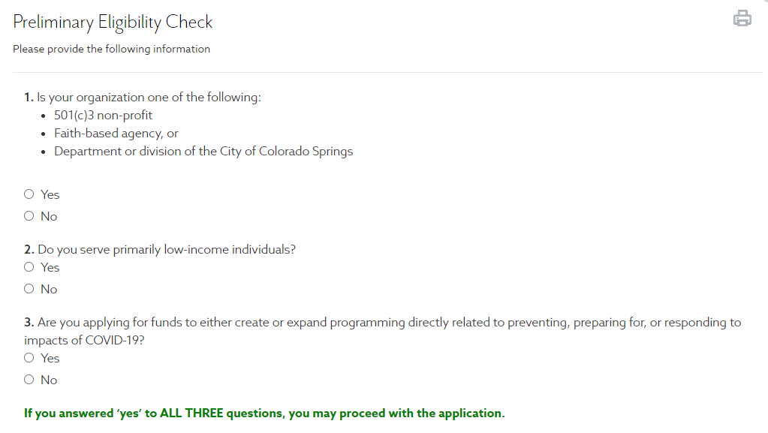
Submitting an Application
Notes:
We want to note that given that the ESG-CV funds are specifically being awarded to help prevent, [prepare for, and respond to the coronavirus, before organization submit an application there will be a preliminary check on eligibility.
If an organization is not eligible based on their answers to this check, they will be unable to proceed to submit an application. PLEASE be sure you have reviewed the guide located on the community development division website and this presentation to ensure your organization is eligible to apply.

Slide 21

Application Review
Alignment with ESG Written Standards
Need and Justification for program
Project Description
Measurable Outcomes
Accessibility
Experience/Past Performance
Coordination of Services
No duplication of benefits
Will the project request prevent, prepare for, and respond to the coronavirus virus outbreak?
Notes:
Once an organization submits an application, what exactly will both internal and external review committees consider to approve your request? Below are some review criteria by which your applications are scored:
Alignment with the written standards- Does your project proposal meet the requirements and goals as outlined in the ESG written standards as outlined by the city of Colorado springs.
Need/justification for program- This is where you make your case. Some of the things reviewers will consider is who else is doing this work for our community? How is your service unduplicated? What are the consequences of not funding your program?
Project description- It is important to be very specific about what you’re asking for and how describe how it fits with a larger project or with your mission.
Measurable outcomes- It’s a good idea to have Measurable Outcomes, but make sure they align with HUD outcome measures. So ask yourself how you count those served?
Accessibility – are your services and facilities accessible to anyone who qualifies?
Experience/Past Performance – The ability to handle different funding streams is vitally important. For those organizations not receiving funding for the first time, how well have you performed and managed grant funding in the past?
Coordination of Services – Does the organization collaborate with other agencies? Collaboration with other agencies is considered extremely positive and it helps serve our citizens better.
Duplication of benefits – Organizations will have to disclose their funding sources for addressing COVID-19 recovery efforts. Reviewers will consider, is this a duplication of benefits?
And most importantly- Will the project request prevent, prepare for, and respond to the coronavirus outbreak?

Slide 22
General information
Application Submission
Applications are due by 11:59pm on June 26th 2020. NO EXCEPTIONS. Incomplete applications will not be considered.
Approval
All applicants will be notified via mail of their approval or denial of their grant application funding request. (Approximately 6-7 weeks)
Written Agreements
After receiving a notification of approval, securing a written agreement takes on average an additional 30 days to finalize.
Post-award technical assistance
Review of project lifecycle through Neighborly, on-site visits, desk monitoring's , etc.
Grant reimbursement requests
After signing their written agreement subrecipients may begin submitting requests for reimbursement for eligible costs. It is important to note that request can be back dated as of January 21st 2020 for coronavirus related and documentable activities only.
Notes:
Application Submission
Applications are due by midnight on June 26th 2020. NO EXCEPTIONS. Incomplete applications will not be considered.
Approval
All applicants will be notified via mail of their approval or denial of their grant application funding request. (Approximately 6-7 weeks)
Written Agreements
After receiving a notification of approval, securing a written agreement takes on average an additional 30 days to finalize.
Post-award technical assistance
Review of project lifecycle through Neighborly, on-site visits, desk monitoring's , etc.
Grant reimbursement requests
After signing their written agreement subrecipients may begin submitting requests for reimbursement for eligible costs. It is important to note that request can be back dated as of January 21st 2020 for coronavirus related and documentable activities only.

Slide 23

THANK YOU!
Naomi Clark
Compliance Analyst II
City of Colorado Springs
Community Development Division
naomi.clark@coloradosprings.gov
Office: 719-385-6609
Catherine Duarte
Senior Analyst
City of Colorado Springs
Community Development Division
catherine.duarte@coloradosprings.gov
Office: 719-385-6876
Rose Lyda
Compliance project manager/Analyst II
City of Colorado Springs
Community Development Division
rose.lyda@coloradosprings.gov
Office:719-385-5340
Notes:
On behalf of the Community Development Division, I want to thank you for taking the time to view this presentation. If you have any questions please feel free to contact any of our team members.

Slide 24
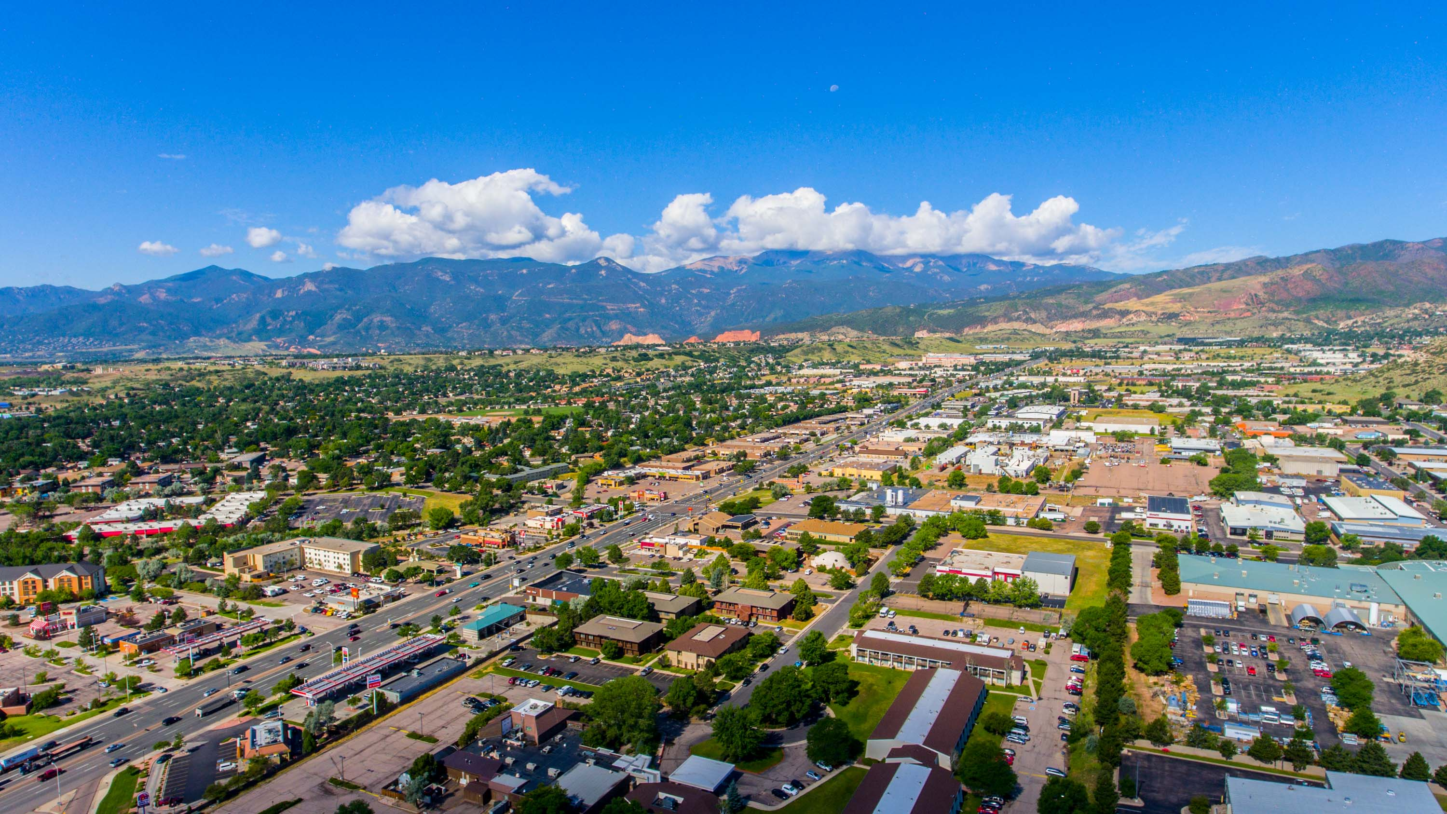
The Community Development Division greatly appreciates the efforts and impact our community partners have on the citizens of Colorado Springs. Please feel free to reach out to naomi.clark@coloradosprings.gov with any grant application inquiries.
For more information and resource guidance on the City of Colorado Springs coronavirus response please visit: https://coloradosprings.gov/economic-development/page/covid-19-response-helping-businesses

