Slide 1



2020 CDBG-CV Public Services Applicant Presentation
Naomi Clark
naomi.clark@coloradosprings.gov
Community Development Division
719-385-6609
June 5th 2020
Notes:
Good Afternoon,
My name is Naomi Clark and I am a team member with the Community Development Division for the City of Colorado Springs. This presentation is for the 2020 Community Development Block grant Public services funding specifically earmarked by the Department of Housing and Urban Development to help combat the coronavirus outbreak.
Today’s presentation will focus on all the information and details organizations will need to successfully determine their eligibility to apply for these funds.

Slide 2

Agenda
Introduction
CDBG Overview
CARES Act and HUD
Funding Priorities
Documenting Eligible Activities
Beneficiaries
Federal Financial Review Standards
Recordkeeping and Reporting
Submitting your application and review
General Information
Notes:
For today’s presentation we will start out with a brief introduction of the funding available and some information on how to determine whether your organization is eligible.
We then take some time to go over the CDBG program elements, requirements, and eligibility information.
From there we will talk more specifically about documenting eligible activities under the CDBG program and move into the outlined Funding priorities as defined by the City of Colorado springs.
Next, we will talk about another CDBG program component, Meeting a national objective, and what that means, and how to determine which national objective your project falls within.
We will them move into a brief discussion about the 2CFR grant requirements, record keeping and reporting, and how to submit your application and how that application will be evaluated.
Lastly, we will end with some general information for all applicants. So lets get started!

Slide 3
Introduction
CARES Act: $2.2 trillion
HUD: $12 billion
Community Development Block Grant (CDBG-CV): $5 billion → City of Colorado Springs: $1.8 million
Emergency Solutions Grant (ESG-CV): $4 billion → City of Colorado Springs: $887k
Who is eligible?
Funding Information
Community Development Block Grant (CDBG-CV)
$ 1 million
Emergency Solutions Grant (ESG-CV)
$400,000
Minimum request amount
$50,000 (both programs)
The Community Development Division has opened applications for the CDBG-CV and ESG-cv funding to help organizations prevent, prepare for, and respond to the coronavirus.
Non-profit organizations, faith based organizations, and public agencies are invited to apply.
Notes:
In response to the coronavirus outbreak, the CARES Act made $12 billion to the U.S. Department of Housing and Urban Development. This first phase of CARES Act funding made $5 billion available in additional Community Development Block grant(CDBG-CV) funds and $4 billion available in Emergency Solutions grant (ESG-CV) funding to all formula grantees in the country. As a grantee jurisdiction, the City of Colorado Springs Community Development Division received a special allocation of CDBG-CV and ESG-CV funds to prevent, prepare for, and respond to the coronavirus and meet our community’s immediate needs.
So who is eligible?
The CDBG-CV application is eligible to all organizations or agencies who fall within either non profit organization status, a faith based organization or agency, and lastly is also open to public agencies. It is important to stress that unlike the regular Community Block Grant Funds made available every year, this awarding period is specifically to assist organization in preventing, preparing for, and responding to the coronavirus.
At this time the City of Colorado springs has approximately 1 million dollars available for CDBG Public Services projects. It is not clear the City will be receiving more funds from HUD, from either the CARES Act funds or any future emergency packages, so the Division is reserving some of those CDBG funds to address other needs, such as economic development activities and any future outbreaks. The minimum request amounts for application submissions for this round of Public Services is $50,000.
Now, we additionally have $400,00 dollars available in our emergency solutions grant funding program. For details about that program please visit our website to view the ESG-CV presentation and review our grant resource guide for details.

Slide 4
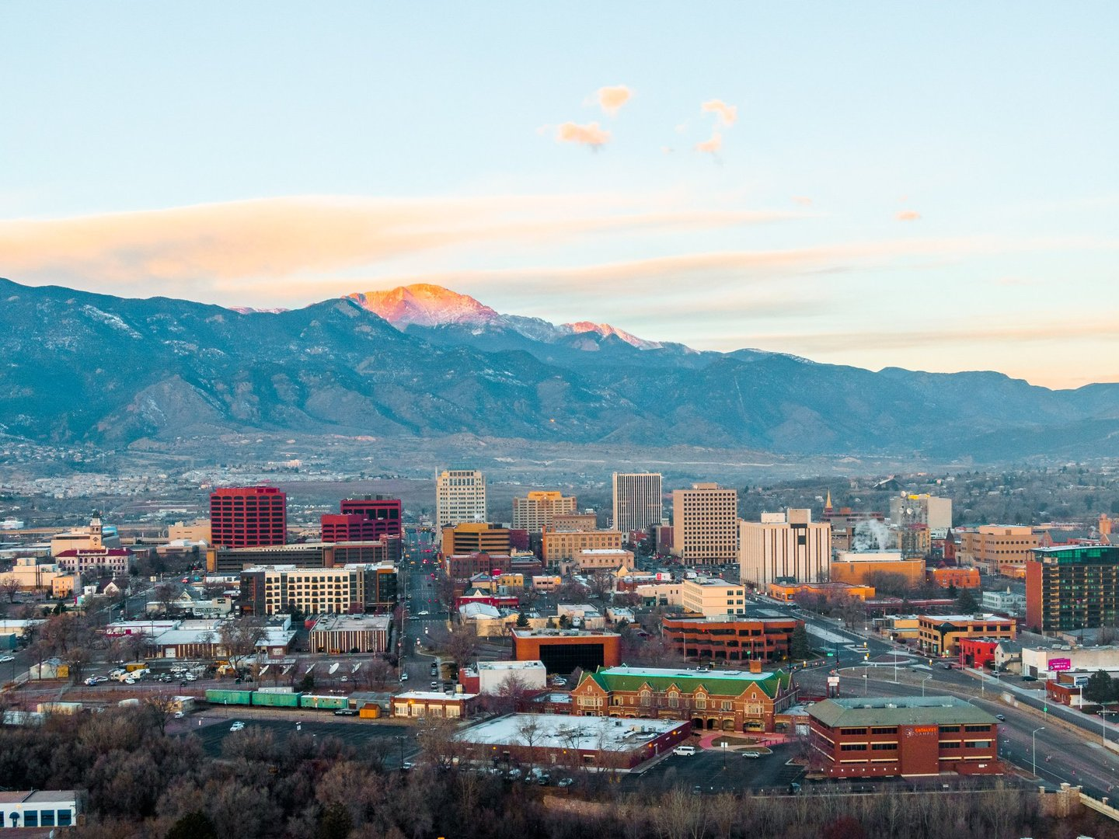
Community Development Block Grant Program (CDBG)
The Community Development Block Grant Program (CDBG) was authorized under Title I of the Housing and Community Development Act of 1974. The focus of the program is to help develop viable urban communities, provide decent and suitable housing, and to expand economic opportunities to principally low-and moderate-income communities.
The Community Development Division manages the City of Colorado Springs entitlement funds from the U.S. Department of housing and Urban Development. Our mission is to create strong, sustainable, inclusive communities and quality affordable homes for all people in Colorado Springs.
Notes:
The Community Development Block Grant Program (CDBG) was authorized under Title I of the Housing and Community Development Act of 1974. The focus of the program is to help develop viable urban communities, provide decent and suitable housing, and to expand economic opportunities to principally low-and moderate-income communities.
The Community Development Division manages the City of Colorado Springs entitlement funds from the U.S. Department of housing and Urban Development. Our mission is to create strong, sustainable, inclusive communities and quality affordable homes for all people in Colorado Springs. To accomplish this, we manage multiple programs under CDBG: Public Services, Public Facilities and Infrastructure, Affordable Housing, and Economic Development. This application window is specifically for Public Services.

Slide 5
CDBG Public Services
Program Types
Eligible program types for our 2020 CV funds include:
Rental relief programs
Childcare programs
Food pantries
Etc.
Service Delivery Costs
General Service Delivery costs can include items such as:
Legal Services
Transportation services
Employment training
The following activities are NOT eligible under the CDBG-CV Public Services grant:
Political activities
General government activities
Purchase of equipment
Direct payments to clients
Construction
Purpose
CDBG Public Services funds generally support service delivery costs for organizations serving low-income populations. These funds must go toward expanding existing services or creating new services to serve those populations.
Beneficiaries
Residents of Colorado Springs
Low-income individuals or communities
Eligibility
Eligible activities can be broken into two categories: eligible service delivery costs and eligible program types.
Notes:
CDBG funds generally support service delivery costs for organizations serving low-income populations. CDBG Public Services grants must specifically go toward expanding existing services or creating new services to serve those populations. So this means that CDBG funds are not to be used as a regular source of income for funding project/programs for organizations. The purpose is really to foster new projects and programs to help them thrive OR help existing programs expand beyond their regular service delivery to offer expanded activities to our citizens. This requirement makes CDBG Public Services a good funding fit for local COVID-19 response because many of you have had to modify or expand your service model to address the sudden uptick in need for services.
Eligible program types can include:
Rental relief programs
Childcare programs
Food pantries, etc.
This is not an exhaustive list, but the idea is that these funds are really meant to address people’s basic needs in the context of the pandemic. How have vulnerable communities been affected by the virus? Many have lost their jobs or substantial income, struggle to access food, medical care, childcare, job training, or keep a roof over their heads.
Eligible activities can be broken into two categories: eligible service delivery costs and eligible program types. General Service Delivery costs can include items such as:
Salary and benefits
Supplies
Overhead (utilities, maintenance, etc.)
Transportation/mileage
The most requested and most common service delivery type applicants submit for fall under Salary and benefits, as providing documentation is easier for most organizations. We will talk further in the presentation about documenting activities for reimbursement, but just some food for thought. Also remember that you’ll need to think about what other disaster response funding you’ve gotten – public or private – and see what they DON’T fund.
Finally let’s talk about what types of activities are NOT eligible under the CDBG funding program. These would include the following:
Political activities
General government activities
Purchase of equipment
Direct cash payments to clients
Construction
While there are a whole list of activities that fall within CDBG Public Services, it is important that along with the basic eligibility activities and programs that organizations keep in mind that as outlined later in the presentation, these funds are specifically to address the impacts of the coronavirus, as such there will be outlined activities the City is seeking to fund directly.

Slide 6

CARES Act and HUD Information
In addition to meeting the basic eligibility requirements for the CDBG and ESG programs (outlined in this guide), all proposed projects MUST provide the following:
A documentable connection between the coronavirus impact on client needs and the applicant’s service delivery.
Assurance that the applicant is not receiving financial assistance from other sources for the expenses detailed in their application AND the ability to determine that a clients are not being not met from other funding sources.
Notes:
In addition to meeting the basic eligibility requirements for the CDBG and ESG programs (outlined in this guide), all proposed projects MUST provide the following:
A documentable connection between the coronavirus impact on client needs and the applicant’s service delivery.
Assurance that the applicant is not receiving financial assistance from other sources for the expenses detailed in their application AND the ability to determine that a clients are not being not met from other funding sources.
As alluded to earlier, as the coronavirus began to impact our communities the Cares Act provided various agencies with funding to help prevent, prepare for, and respond to the crisis.
HUD guidelines are very clear in that this funding most go towards that aim. As such, applicants need to be mindful that in addition to providing a detailed narrative in their applications on how the coronavirus has impacted their clients and programmatic activities, that ultimately if an organization is unable to provide a very detailed documentable connection between their request and the coronavirus impact on their clients, they would be ineligible for reimbursement.
Additionally, HUD has been very clear that these funds are not meant to be a duplication of funding an organization may already have or have available. Please be sure you take a look on the HUD website for their guidance on the duplication of benefit. It is very clear and basically advises that if an organization either has the funds needed to address the coronavirus impact on their clients and/or can obtain the funds from another source, whether that be private, public, etc. type funds, that these grant funds should not be used. Please be sure when considering submitting an application that you consult with your finance team and board to ensure that you have exhausted all options to address your clients needs.

Slide 7
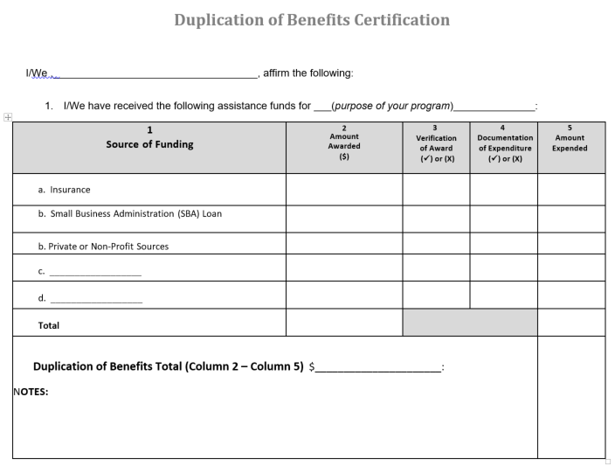
Notes:
Additionally, HUD has been very clear that these funds are not meant for activities that other disaster recovery funds are covering. It is very clear and basically advises that if an organization either has the funds needed to address the coronavirus impact on their clients and/or can obtain the funds from another source, whether that be private, public, etc. type funds, that these grant funds should not be used.
Please be sure when considering submitting an application that you consult with your finance team and board to ensure that you have exhausted all options to address your clients needs. This is a worksheet template that all awardees will need to fill out prior to signing their CDBG-CV agreement, so feel free to use this in conducting your own pre-application duplication of benefits analysis.

Slide 8
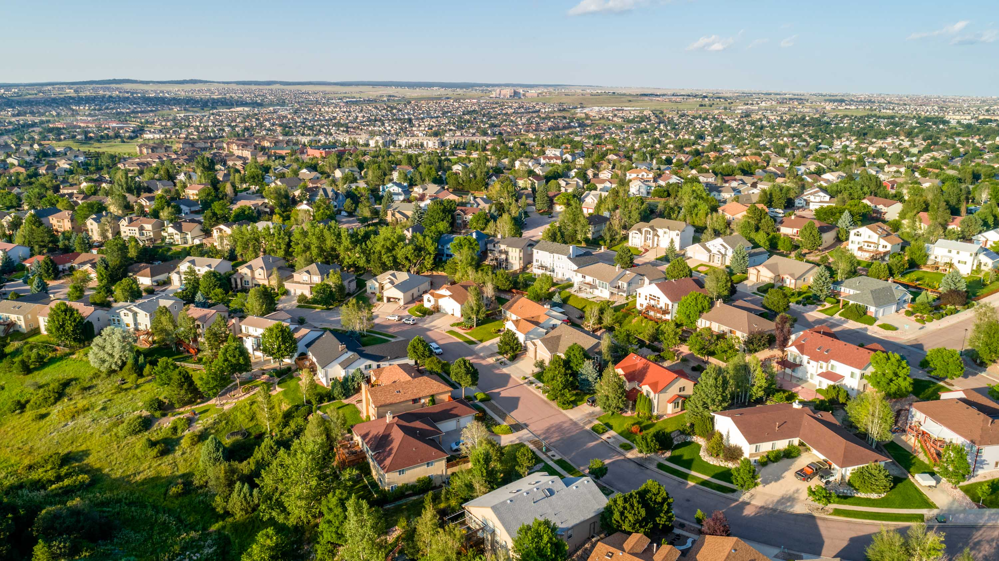
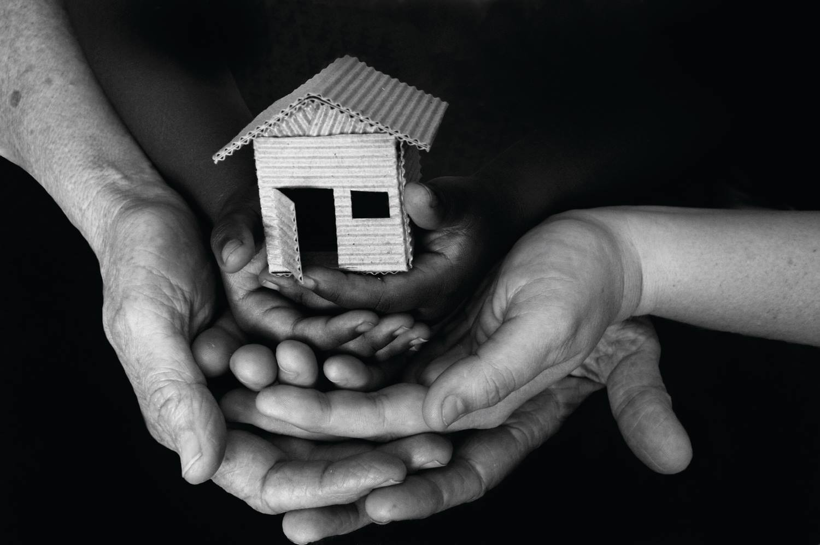
Funding Priorities
1. Housing Stability
2. Whole Family Health and Safety
These are programs that serve households who have lost their income due to COVID-19 find and keep safe and stable housing. Activities that are eligible under this priority include: Rental housing subsidies, subsistence payments, and security deposits.
These are programs that address the physical and mental health of all generations in relation to COVID-19 needs. Activities that are eligible include: Senior services, services for persons with disabilities, youth services, child care services, substance abuse services, services for victims of domestic violence (this includes dating violence, sexual assault or stalking), mental health services, food banks, and health services.
Notes:
For the current CDDBG-CV grant funding the city has outlined the following funding priorities for awarding.
First Housing stability
These are programs that serve households who have lost their income due to COVID-19 find and keep safe and stable housing. Activities that are eligible under this priority include: Rental housing subsidies, subsistence payments, and security deposits.
So lets take subsistence payments as an example . subsistence payments are One-time or short-term (no more than three months) emergency payments on behalf of individuals or families, generally for the purpose of preventing homelessness. Examples include utility payments to prevent cutoff of service, and rent/mortgage payments to prevent eviction. You will have to verify clients’ income and that their inability to pay is directly due to the coronavirus.
Next is Whole family health and safety. These are programs that address the physical and mental health of all generations in relation to COVID-19 needs. Activities that are eligible include: Senior services, services for persons with disabilities, youth services, child care services, substance abuse services, services for victims of domestic violence, mental health services, food banks, and health services.
As an example childcare services are generally Services that will benefit children (generally under age 13).

Slide 9


Funding Priorities
3. Resilience
Key Populations
These are programs that help individuals and families emerge from the COVID-19 crisis stronger. Activities that are eligible include: Legal services, transportation services, and employment training.
Households making less than 60% area median income who have experienced a loss or reductions of income due to the coronavirus.
Notes:
The next priority for funding falls under resilience
These are programs that help individuals and families emerge from the COVID-19 crisis stronger. Activities that are eligible include: Legal services, transportation services, and employment training.
As an example, legal services with a coronavirus connection might include costs of legal representation or mediation for low-income clients in housing or employment disputes.
The last priority for CDBG-CV funding is that your proposed project serves the key population:
Households making less than 60% area median income AND who have experienced a loss or reductions of income due to the coronavirus.
Just a note about how to document income: we realize that if your client lost their job, their income is zero, so the 60% AMI is to be measured at their last paycheck.

Slide 10
Documenting Eligible Activities
Example 1: Housing Unlimited
Application request: Salary and benefits for their newly hired employee Lemon Drop.
Potential documentation:
Timesheets
Mileage reimbursement documentation
Payroll Journal
Benefits statement
Job description
Eligible beneficiaries served with demographic breakdown, both unduplicated and cumulative (year-to-date)
Client intake forms
Questions Housing Unlimited should consider before submitting an application for CDBG-CV funds:
Is Lemon Drop carrying out work that prevents, prepares for, and responds to coronavirus related activities?
Can we track beneficiaries and capture income and demographics?
How accurate and detailed is our record keeping in relation to Lemon Drop’s documentable time?
Do we have the templates and/or software in place to be able to keep track of Lemon Drop’s time accurately and in a timely manner?
As CDBG is a reimbursement grant program, one of the most important areas organizations must focus on is providing detailed, accurate documentation to support any request for a CDBG eligible activity.
Every activity must be tied to eligible beneficiaries. In other words, how does this work directly enable your organization to serve its clients?
The documentation submitted for CDBG-CV grant funds must be able to demonstrate:
Notes:
Example 1: Housing Unlimited
Application request: Salary and benefits for their newly hired employee Lemon Drop.
Potential documentation:
Timesheets
Mileage reimbursement documentation
Payroll Journal
Benefits statement
Job description
Eligible beneficiaries served with demographic breakdown, both unduplicated and cumulative (year-to-date)
Client intake forms
Questions Housing Unlimited should consider before submitting an application for CDBG-CV funds:
Is Lemon Drop carrying out work that prevents, prepares for, and responds to coronavirus related activities?
Can we track beneficiaries and capture income and demographics?
How accurate and detailed is our record keeping in relation to Lemon Drop’s documentable time?
Do we have the templates and/or software in place to be able to keep track of Lemon Drop’s time accurately and in a timely manner?

Slide 11
Documenting Eligible Activities
Example 2: Family Services, Inc.
Application request: Rental assistance
Documentation Family Services Inc. could submit for reimbursement:
Client intake forms with income verification
Proof of coronavirus-related job loss or loss of income
Duplication of benefits certification from client
Copy of lease and past payments
Payment copies to property owner
Questions Family Services Inc. should consider before submitting an application for CDBG-CV funds:
How detailed are our client intake forms? How do we document that case activity is specifically related to the coronavirus? How do we distinguish coronavirus related time vs. regular case management in documentation?
Do we have a case management model that can gather all of these documents and manage correspondence with property owner?
As CDBG is a reimbursement grant program, one of the most important areas organizations must focus on is providing detailed, accurate documentation to support any request for a CDBG eligible activity.
The documentation submitted for CDBG-CV grant funds must be able to demonstrate a clear and concise connection between the request and the coronavirus.
Remember:
No direct payments to beneficiary
Notes:
Lets take a look at another example
Example 2: Family Services, Inc.
Application request: Rental assistance
Documentation Family Services Inc. could submit for reimbursement:
Client intake forms with income verification
Proof of coronavirus-related job loss or loss of income
Duplication of benefits certification from client
Copy of lease and past payments
Payment copies to property owner
Questions Family Services Inc. should consider before submitting an application for CDBG-CV funds:
How detailed are our client intake forms? How do we document that case activity is specifically related to the coronavirus? How do we distinguish coronavirus related time vs. regular case management in documentation?
Do we have a case management model that can gather all of these documents and manage correspondence with property owner?

Slide 12
Meeting a National Objective
All CDBG Public Services projects must benefit low to moderate income (LMI) persons.
Low to Moderate Clientele Benefit
Low to moderate Area Benefit
These are activities or programs that benefits a specific group of LMI residents regardless of their address. Examples include:
Homeless shelter operations
Rental assistance
Food pantries
Domestic violence shelters and services
Most public services for vulnerable populations
These are activities or programs that benefit all residents in a defined geographic area (within the City) that has a majority of LMI residents. Examples include:
Neighborhood-based transit services
Community center programs in high poverty Census tracts
Notes:
Now let’s talk about meeting a national objective. The CDBG program’s entire mission is to serve low-income communities. All CDBG Public Services funding requests received by the City must meet the objective of benefitting low to moderate income (LMI) persons.
There are different standards by which jurisdictions and their subrecipients can meet this, depending on the program and activity types.
In the application, we’ll ask you to choose which benefit your program fits:
LMC
These are activities or programs that benefits a specific group of LMI residents regardless of their address. Examples include:
Almost all applicants for CDBG should fall within this national objective.
the next is LMA benefit. These are activities or programs that benefit all residents in a defined geographic are that has a majority of LMI residents. Examples include:
Neighborhood-based transit services
Community center programs in high poverty Census tracts
It is rare to see applicants who fall within this objective. If you have any questions about this, please reach out.

Slide 13
Meeting a National Objective
What national objective standard does your project meet? | How do you document this?
Low-moderate income clientele (LMC) At least 51% of the beneficiaries of the activity must be LMI. | Client intake forms that capture total income and household size You serve a population presumed to be LMI (homeless, victims of domestic violence, developmentally disabled adults, etc.)
Low –moderate income area (LMA) This is rare for Public Services activities. LMA activities serve whole geographic areas that are majority (51% or more) LMI. | Provide address of service with current Census tract income data.
Notes:
When considering which national objective you fall within and want to put into your application the biggest questions you will want to ask is who are your services benefitting and how will you document that benefit?

Slide 14
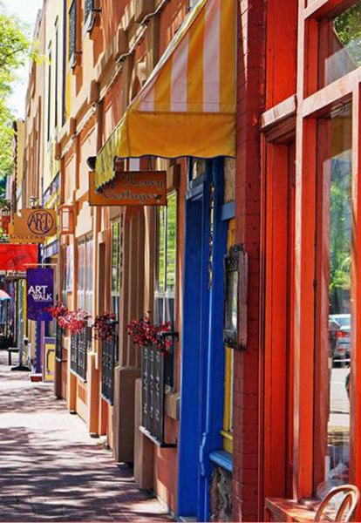
Grant Overview for Applicants
2 CFR Part 200
This subsection of chapter 2 of the Code of Federal Regulations specifically outlines the uniform administrative requirements, cost principles, and audit requirements for federal awards.
Internal Controls
Standards for Financial Management
Cost Principles
Audit Requirements
Procurement Standards
Conflict of Interest
Program Income
Direct and Indirect Costs
Notes:
For all applicants and awardees it is important that they have taken the time to review the Overview for grant awardees. This is a subsection of chapter 2 of the Code of Federal Regulations specifically outlines the uniform administrative requirements, cost principles, and audit requirements for federal awards. If this sounds foreign to you in your role, you might need to sit down with your finance officer or CPA to go over this and be sure that your organization complies.
This code goes over
Internal Controls
Standards for Financial Management
Cost Principles
Audit Requirements
Procurement Standards
Conflict of Interest
Program Income
Direct and Indirect Costs
It is critical that applicants understand these requirements in order to receive a federal award.

Slide 15
Record Keeping and Reporting
Record Keeping
HUD requires that the City of Colorado Springs keep records on file that are accurate, complete, and orderly. As such, all awarded organizations are also responsible for maintaining their records in the same accurate, complete, and orderly fashion. Subrecipients are responsible for maintaining records in at least 3 major categories:
Administrative Records
Financial Records
Project/Case Files
These records must be maintained for the duration of the awarded grant plus 6 years. At any time the City of Colorado Springs reserves the right to request these records for review.
Reporting
Requests for reports may be:
Monthly
Quarterly
Monitoring documentation request
Reports should be accurate, complete, orderly, and timely.
Notes:
Record Keeping
HUD requires that the City of Colorado Springs keep records on file that are accurate, complete, and orderly. As such, all awarded organizations are also responsible for maintaining their records in the same accurate, complete, and orderly fashion. Subrecipients are responsible for maintaining records in at least 3 major categories:
Administrative Records
Financial Records
Project/Case Files
These records must be maintained for the duration of the awarded grant plus 6 years. At any time the City of Colorado Springs reserves the right to request these records for review.
Reporting
Requests for reports may be:
Monthly
Quarterly
Monitoring documentation request
Reports should be accurate, complete, orderly, and timely.
Applicants should understand that if awarded their performance in maintaining accurate, complete, timely, and orderly reports and records will be evaluated as a part of not only the award process, but continued opportunities for funding in the future.

Slide 16
Submitting an Application
Neighborly: All applicants must register through the city’s online grant application platform Neighborly software. Please visit https://portal.neighborlysoftware.com/coloradospringsco/Participant/Login to register for your online profile and complete the grant application. IMPORTANT: All grant applications must be submitted through the online portal. No paper applications accepted.
SAM registration: All applicants must be registered under the system for award management to do business with the U.S. government. Please visit: www.SAM.gov to register your organization.
DUNS #: All Applicants must have a registered DUNS number to be a grant awardee. Please visit: https://fedgov.dnb.com/webform/ to check or receive your DUNS number.
Notes:
Neighborly: All applicants must register through the city’s online grant application platform Neighborly software. Please visit https://portal.neighborlysoftware.com/coloradospringsco/Participant/Login to register for your online profile and complete the grant application. IMPORTANT: All grant applications must be submitted through the online portal. No paper applications accepted.
SAM registration: All applicants must be registered under the system for award management to do business with the U.S. government. Please visit: www.SAM.gov to register your organization.
DUNS #: All Applicants must have a registered DUNS number to be a grant awardee. Please visit: https://fedgov.dnb.com/webform/ to check or receive your DUNS number.
These are some of the very first checks for eligibility that staff conducts before moving projects on for external review, so make sure your registration is active and up to date.

Slide 17
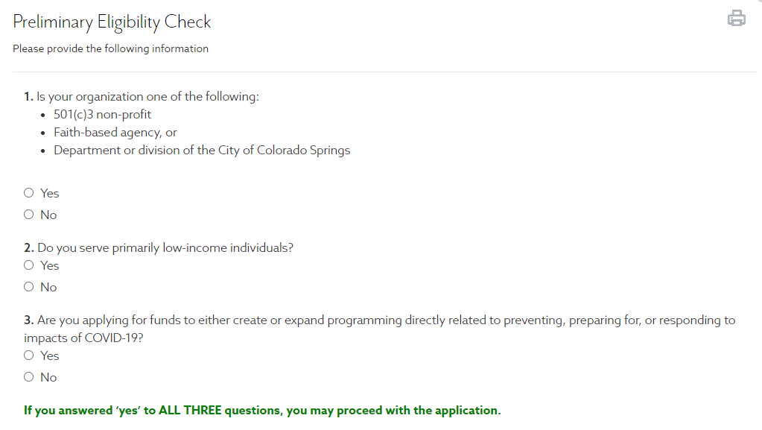
Submitting an Application
Notes:
We want to note that given that the CDBG-CV funds are specifically being awarded to help prevent, [prepare for, and respond to the coronavirus, before you submit an application there will be a preliminary check on eligibility.
If an organization is not eligible based on their answers, they will be unable to proceed to submit an application. PLEASE be sure you have reviewed the guide and this presentation to ensure your organization is eligible to apply.

Slide 18

Application Review
Alignment with CV priorities
Does it meet a National Objective? Is it an Eligible Activity?
Need and Justification for program
Project Description
Measurable Outcomes
Accessibility
Experience/Past Performance
Coordination of Services
No duplication of benefits
Will the project request prevent, prepare for, and respond to the coronavirus outbreak?
Notes:
Once an organization submits an application, what exactly will both internal and external review committees consider to approve your request? Below are some review criteria by which your applications are scored:
How well does your request align with the funding priorities outlined by the city?
Meeting national objective and eligibility means you can correctly document that you serve low-income residents and that your costs are allowable under CDBG regs.
This is where you make your case. Who else is doing this work? How is your service unduplicated? What are the consequences of not funding your program?
Be specific about what you’re asking for and how it fits with a larger project or with your mission.
It’s a good idea to have Measurable Outcomes, but make sure they align with HUD outcome measures. How do you count those served?
Accessibility – are your services and facilities accessible to anyone who qualifies?
Experience/Past Performance – ability to handle different funding streams is important.
Coordination of Services – Collaboration with other agencies is a good thing.
No duplication of benefits – You will have to disclose your funding sources for addressing COVID-19 recovery efforts
And most importantly- Will the project request prevent, prepare for, and respond to the coronavirus outbreak?

Slide 19
General information
Application Submission
Applications are due by 11:59pm MST on June 26th 2020. NO EXCEPTIONS. Incomplete applications will not be considered.
Approval
All applicants will be notified via mail of their approval or denial of their grant application funding request. (Approximately 6-7 weeks)
Written Agreements
After receiving a notification of approval, securing a written agreement takes on average an additional 30 days to finalize.
Post-award technical assistance
Review of project lifecycle through Neighborly, on-site visits, desk monitoring's, etc.
Grant reimbursement requests
After signing their written agreements, subrecipients may begin submitting requests for reimbursement for eligible costs. It is important to note that request can be back dated as of January 21st 2020 for coronavirus-related and documented, eligible activities only.
Notes:
Application Submission
Applications are due by midnight (11:59pm) on June 26th 2020. NO EXCEPTIONS. Incomplete applications will not be considered.
Approval
All applicants will be notified via mail of their approval or denial of their grant application funding request. (Approximately 6-7 weeks)
Written Agreements
After receiving a notification of approval, securing a written agreement takes on average an additional 30 days to finalize.
Post-award technical assistance
Review of project lifecycle through Neighborly, on-site visits, desk monitoring's, etc.
Grant reimbursement requests
After signing their written agreement subrecipients may begin submitting requests for reimbursement for eligible costs. It is important to note that request can be back dated as of January 21st 2020 for coronavirus-related and documented, eligible activities that are specifically outlined in your agreement.

Slide 20
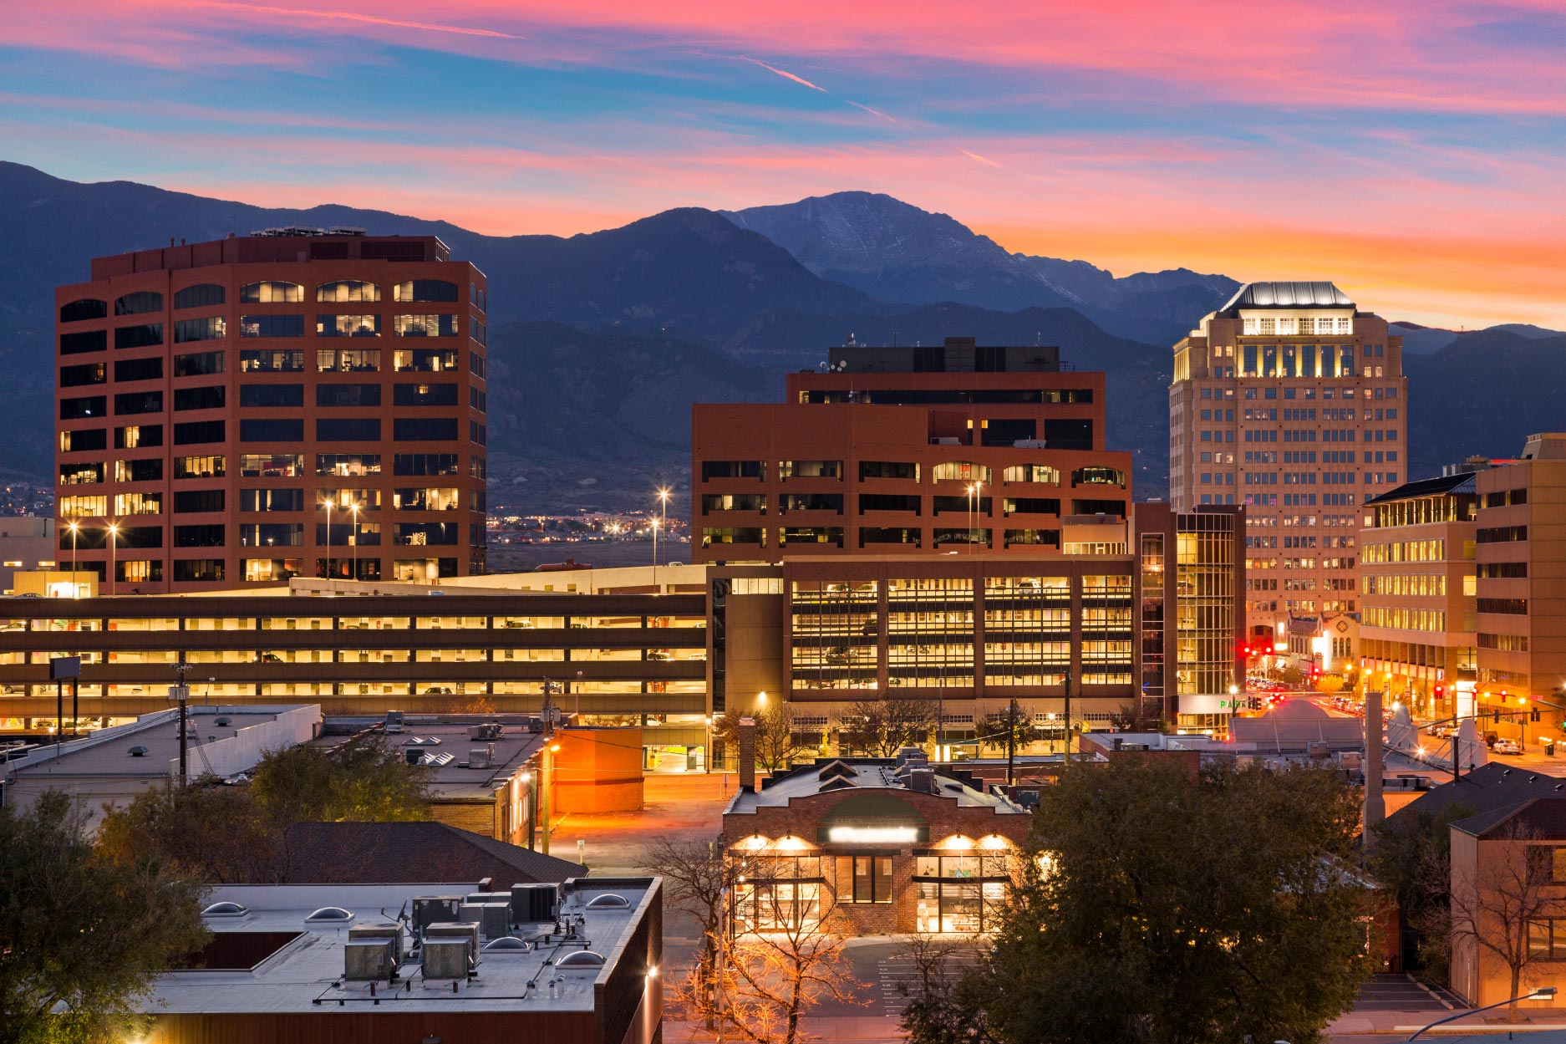
THANK YOU!
Naomi Clark
Compliance Analyst II
City of Colorado Springs
Community Development Division
naomi.clark@coloradosprings.gov
Office: 719-385-6609
Catherine Duarte
Senior Analyst
City of Colorado Springs
Community Development Division
catherine.duarte@coloradosprings.gov
Office: 719-385-6876
Rose Lyda
Compliance project manager/Analyst II
City of Colorado Springs
Community Development Division
rose.lyda@coloradosprings.gov
Office:719-385-5340
Notes:
On behalf of the Community develop. Div. I want to thank you for taking the time to view this presentation. If you have any questions please feel free to contact any of our team members.

Slide 21
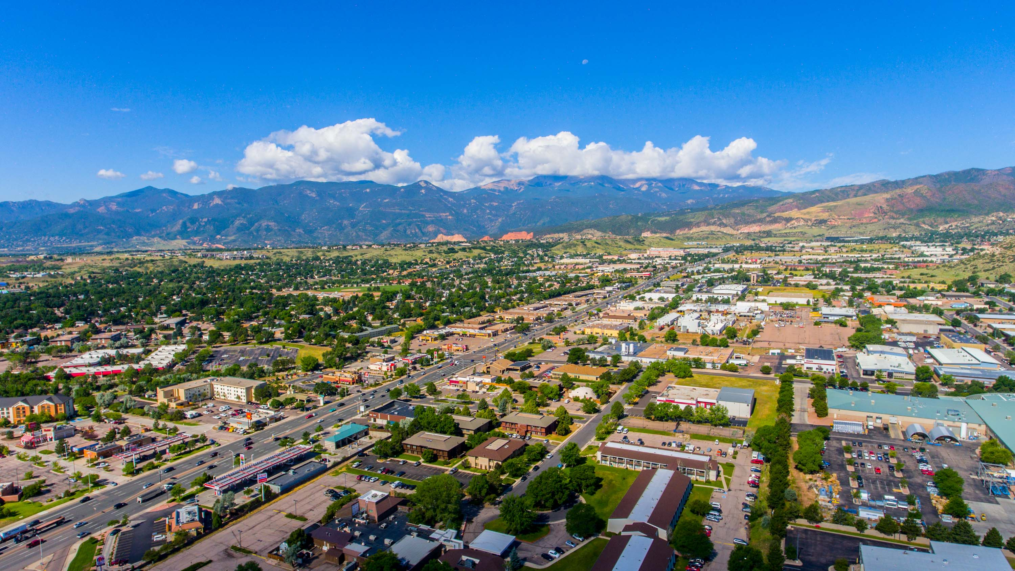
The Community Development Division greatly appreciates the efforts and impact our community partners have on the citizens of Colorado Springs. Please feel free to reach out to naomi.clark@coloradosprings.gov with any grant application inquiries.
For more information and resource guidance on the City of Colorado Springs coronavirus response please visit: https://coloradosprings.gov/economic-development/page/covid-19-response-helping-businesses

