Slide 1

City of Colorado Springs
Stormwater Enterprise (SWENT)

Slide 2
2017 Ballot Issue 2A Summary
  Authorized the collection of stormwater service fees beginning July 1, 2018 and ending July 1, 2038, for the sole purpose of funding through a City enterprise, the construction, improvement, and operation and maintenance of public stormwater facilities and infrastructure.
  Residential fee of $5 per month
  Non-residential fee of $30 per acre for parcels 5 acres or less
  Non-residential parcels larger than 5 acres assessed individually

Slide 3
Which properties/parcels will experience the fee?
  The fee will only be assessed on developed or improved parcels within the City limits
  Coordinated residential billing through CSU. $5 per residential unit on the monthly water service bill. (Approx. 130,000 residential parcels)
  Non-residential billing through third party billing company (T.B.T). (Approx. 27,000 non-residential parcels)

Slide 4
What will the fee be used for?
Projected Revenue and Expenses
  The fee is expected to generate approximately $16-$17 Million per year.
  SWENT projected expenditures:
    Capital Projects – Approximately $10 Million per year
      Engineering, construction management, and construction services are contracted out to local consultants and general contractors
    Municipal Separate Storm Sewer System Permit (MS4 Permit) program compliance – Approximately $3.2 Million
    Stormwater infrastructure maintenance operations – Approximately $4 Million

Slide 5
Current SWENT Staffing
Staffing Level
  Current staff of 67 FTEs, 3 Temporary Employees
    26 full time positions within
      Water Quality Program (MS4 Compliance)
      Stormwater Projects Program (capital projects team and stormwater projects delivery team)
      Stormwater Review Program
    3 Temporary positions within Customer Service Center
    41 full time positions within Drainage Operations & Maintenance Team

Slide 6
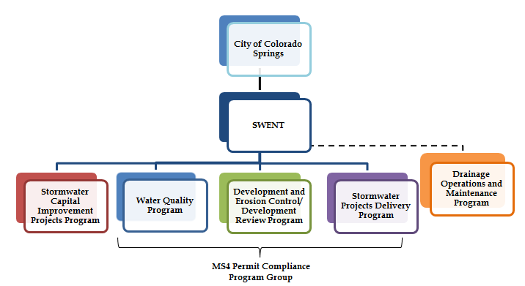
Drainage Operations & Maintenance Activities

Slide 7
Drainage Operations & Maintenance Activities Cont.
City of Colorado Springs Drainage Infrastructure
  Over 195 square miles
  Over 120 publicly maintained regional and sub-regional detention ponds/facilities
  Over 270 miles of drainage channels; includes natural, armored, and concrete lined
  Approximately 25,000 inlets and manholes
  Over 500 miles of underground storm sewer piping

Slide 8
Water Quality Program Activities

Slide 9
Water Quality Program Activities Cont.
Core Functions
  MS4 Permit compliance tracking and reporting
  Illicit discharge tracking and response
  Public outreach
  Construction site erosion control inspections
  Private BMP inspection and tracking
  Industrial Facilities Management Program
  Municipal Facilities Runoff Control Program (MFRCP)
  Wet and dry weather water quality monitoring

Slide 10
Development and Erosion Control Review

Slide 11
Development and Erosion Control Review Cont.
Completed reviews of over 2,700 drainage related development submittals
  Issued comments, ensured comments addressed prior to recommending approval
Document reviews completed on time over 97% of the time

Slide 12
Stormwater Projects Delivery Programs

Slide 13
Stormwater Projects Delivery Programs Cont.
Projects include the construction of detention facilities, channel stabilization, storm sewer infrastructure repair/replacement, flood reduction, water quality improvement projects, etc.
Total of 75 capital projects scheduled to continue or commence in 2018
Total 2017 expenditures:
  Total City encumbered cost of $13,100,000
  Total City actual expenditure of $7,847,522

Slide 14
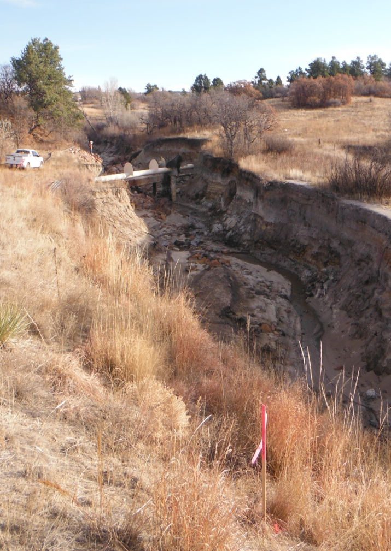
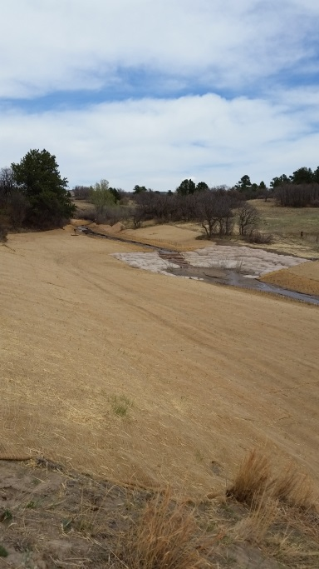
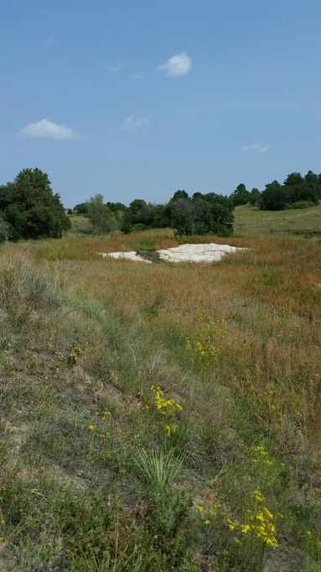
IGA Project #6 – USAFA Drainage – Monument

Slide 15
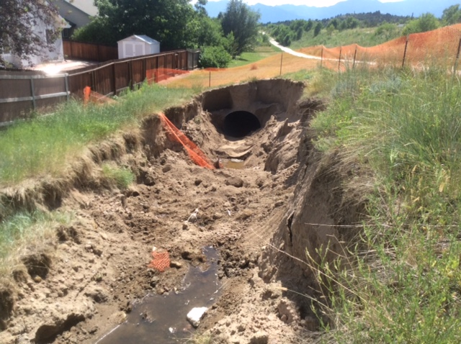
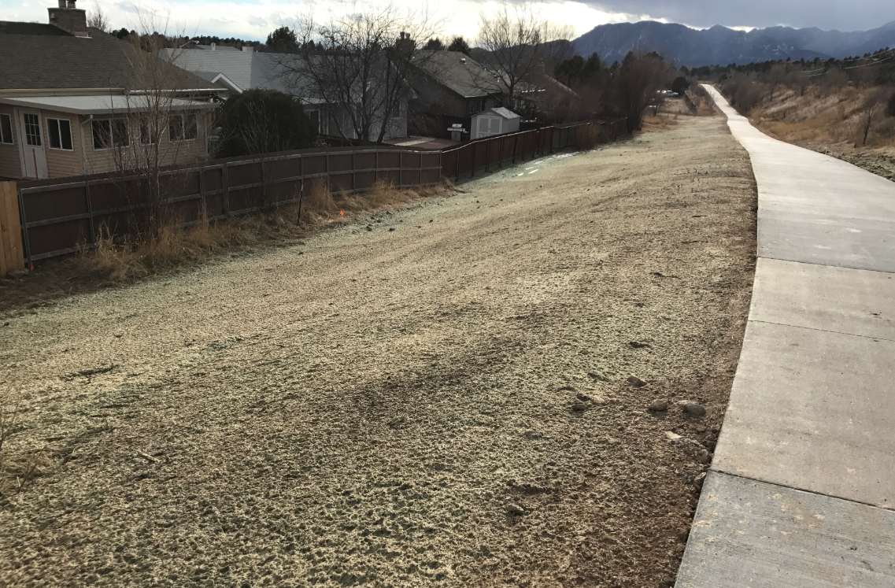
Heatherdale CMP Repair

Slide 16
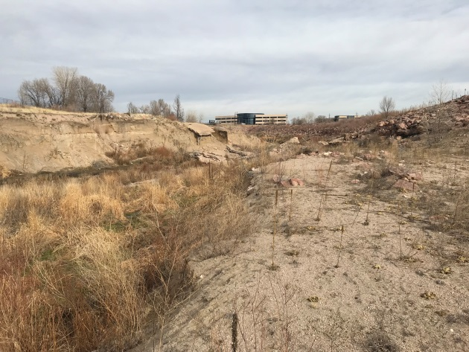
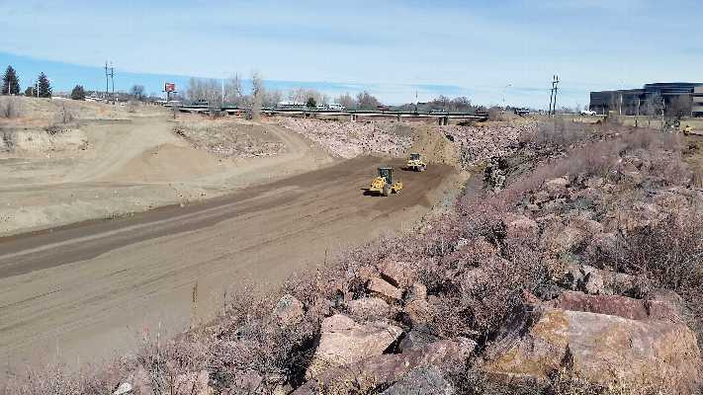
IGA Project #26 – Sand Creek Stabilization South of Platte

Slide 17
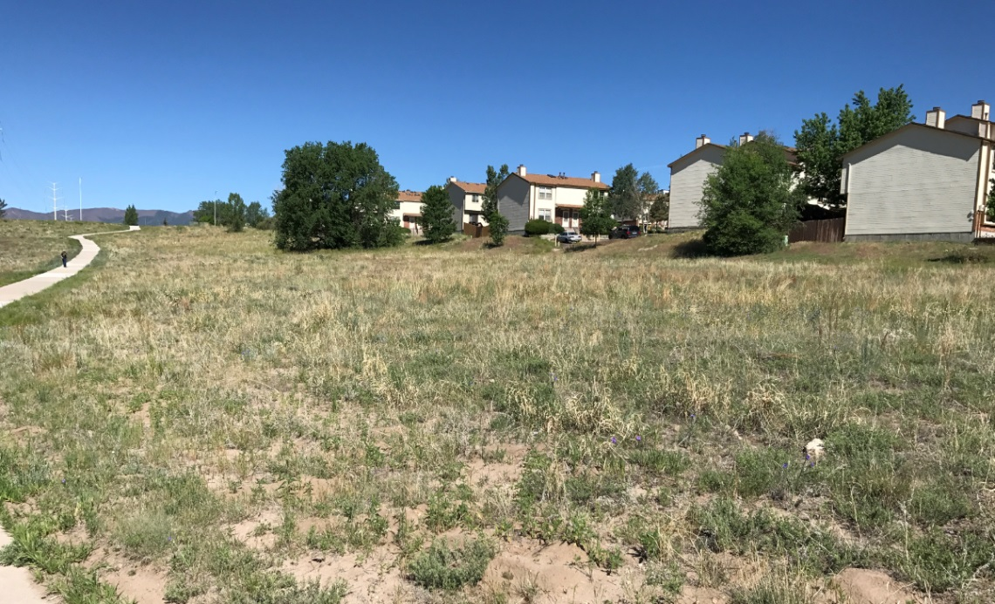
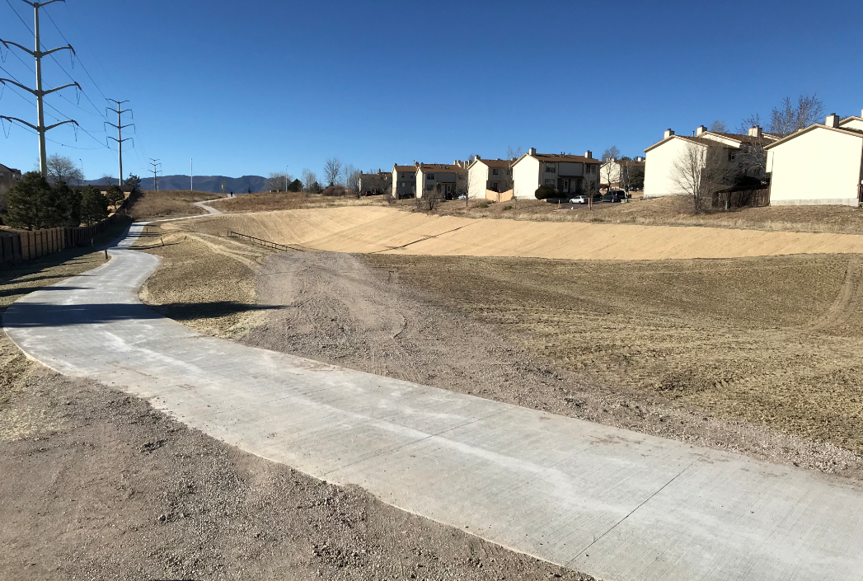
IGA Project #65 – Yellowwood Detention Facility

Slide 18
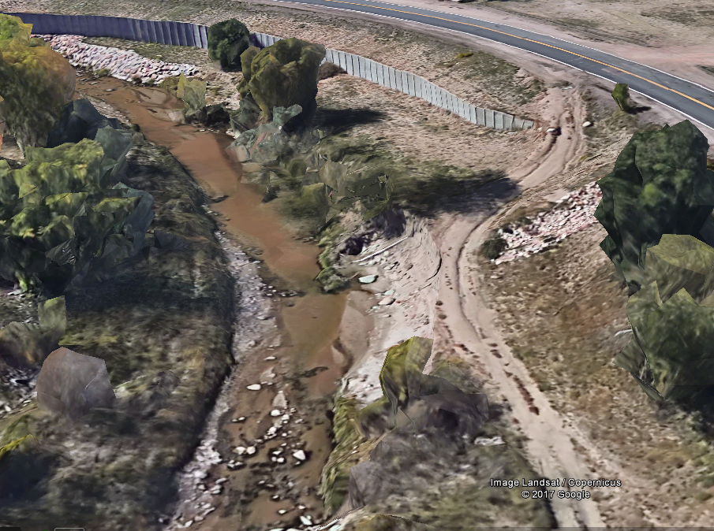
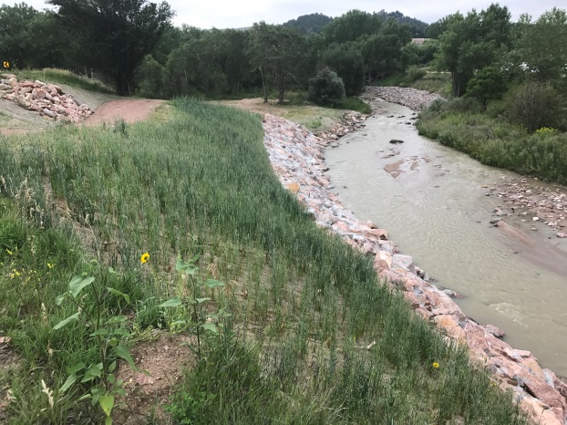
IGA Project #0 – FEMA/Grant Projects, Monument Creek at Mark Dabling

Slide 19
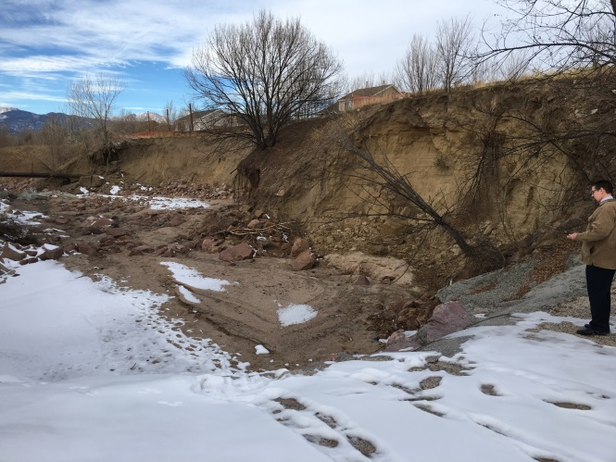
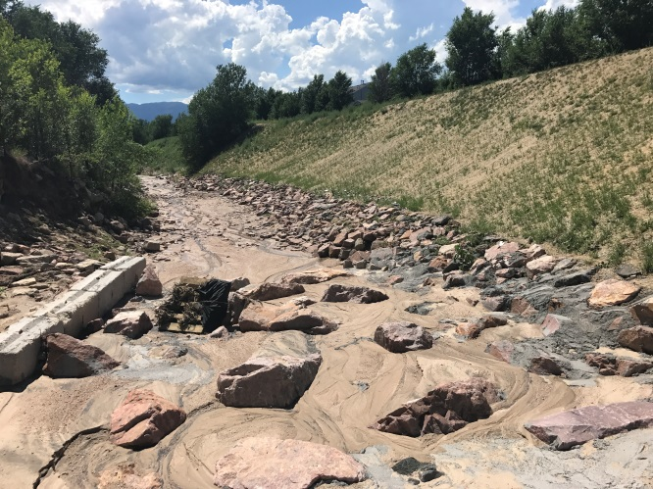
IGA Project #0 – FEMA/Grant Projects, East Fork Sand Creek Erosion – Site 1

Slide 20
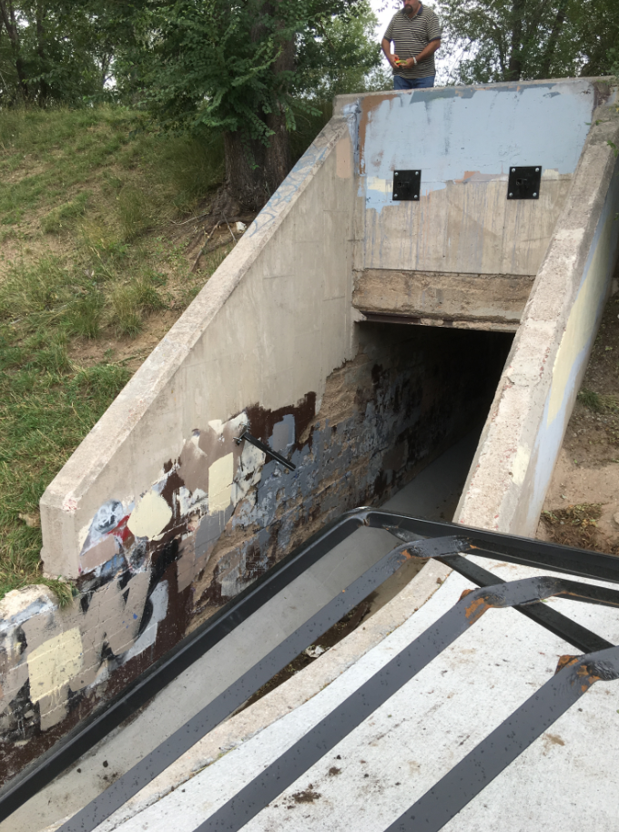
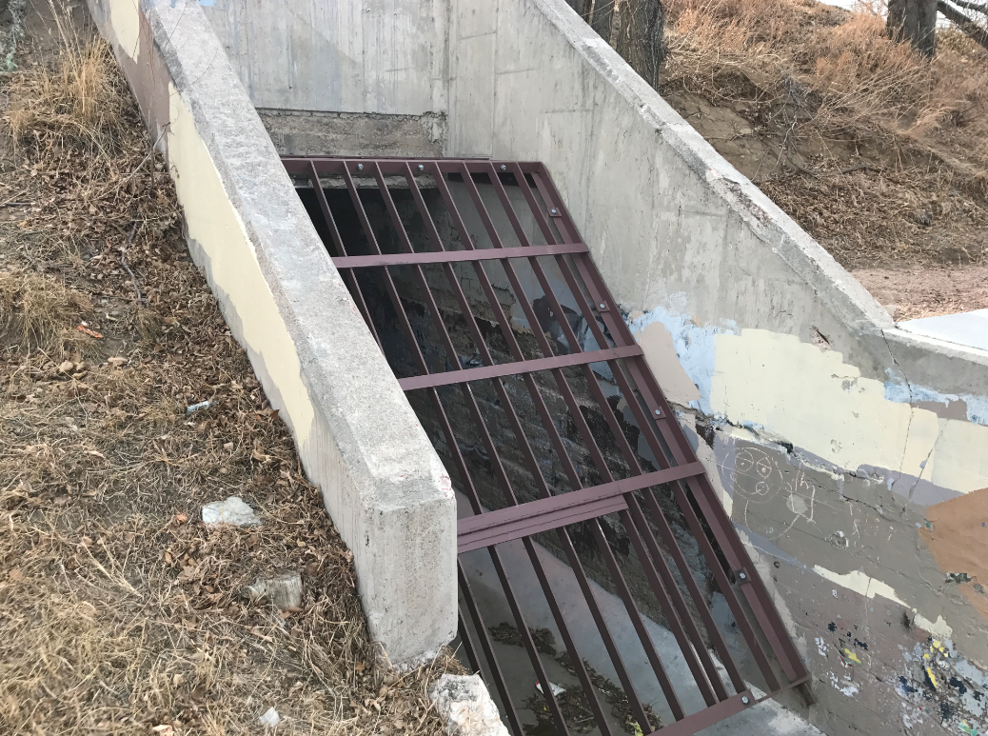
La Salle Channel Grate Installation

Slide 21
2A Oversight Committee
  Transparency and accountability
  Committee of the City Council
    Meets quarterly, open to the public, first meeting May 17th
    7 member panel appointed by Council
      2 members with experience or training in civil engineering, water law, or water resources planning, flood control or related fields
      1 member actively engaged in the business of property development or homebuilding
      1 member who owns or represents a commercial property or business
      1 member who owns and resides in a single-family residence
      1 member who represents a public institution, school, educational institution, or government entity that owns property in the City
      1 member who represents a nonprofit organization located within the City

Slide 22
How is SWENT different from before?
The previous fee was implemented by City Council. The new fee was voted in by ballot initiative.
Previously, the fee was calculated based on a ratio of impervious and pervious area. The new fee will be based on overall area.
Previously, certain uses received a reduction in fee, i.e. educational, institutional, non-profit. The new fee will be assessed equal for all uses, including governmental.
Previously, residential units were sent a separate SWENT fee bill. The residential fee will now be located on the CSU water bill ($5/month).

Slide 23
Thank you!!
Questions or need additional info?
  719-385-STRM (7876)
  https://coloradosprings.gov/water-resources-engineering-stormwater

